Slide 1
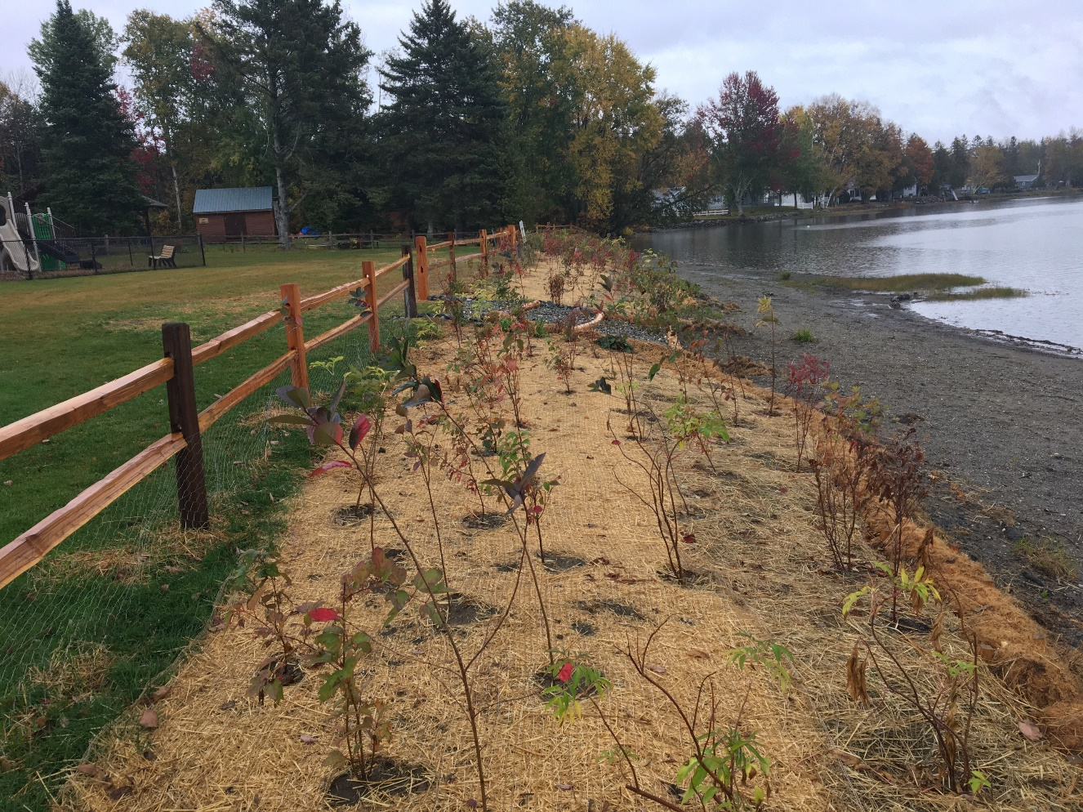
Finding Support and Calculating Benefits of Lakeshore BMPs Natural Shoreland Erosion Control Certification
January 23rd 2024
Ben Copans - Watershed Planner Water Investment Division

Slide 2
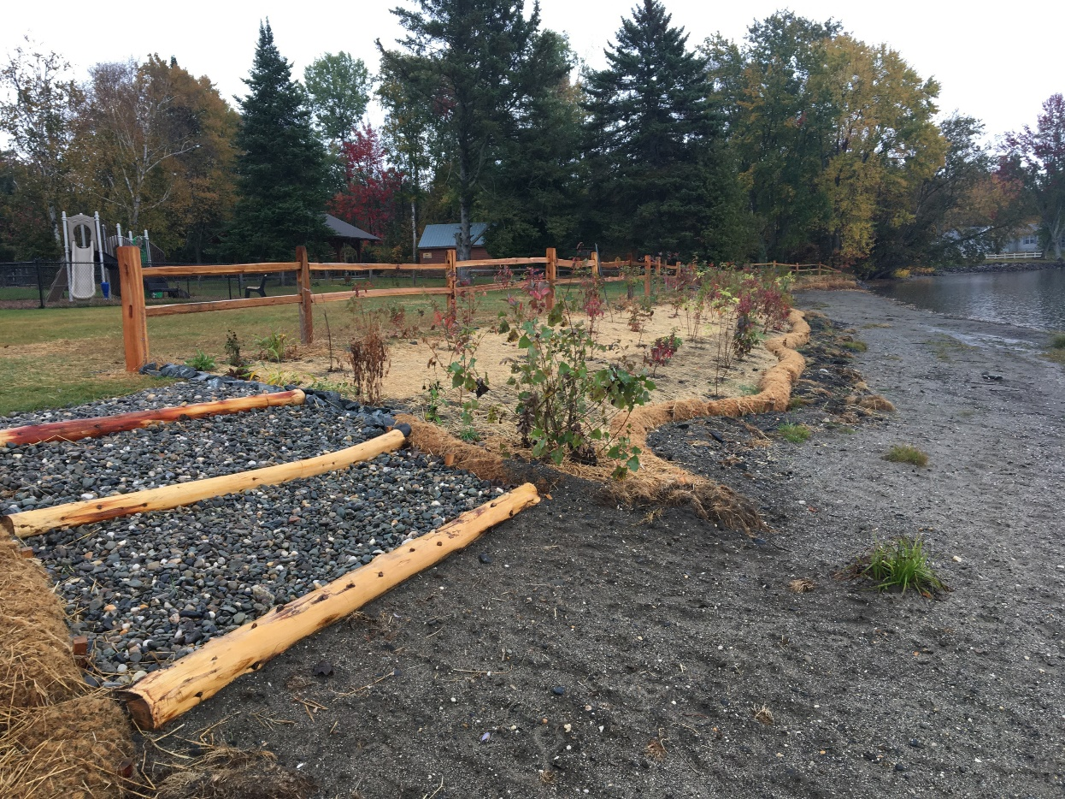
Presentation outline
Partnerships and technical support to for lakeshore projects
Potential funding sources
Enhancement grants
Formula grants
Project types and phosphorus reduction calculators

Slide 3
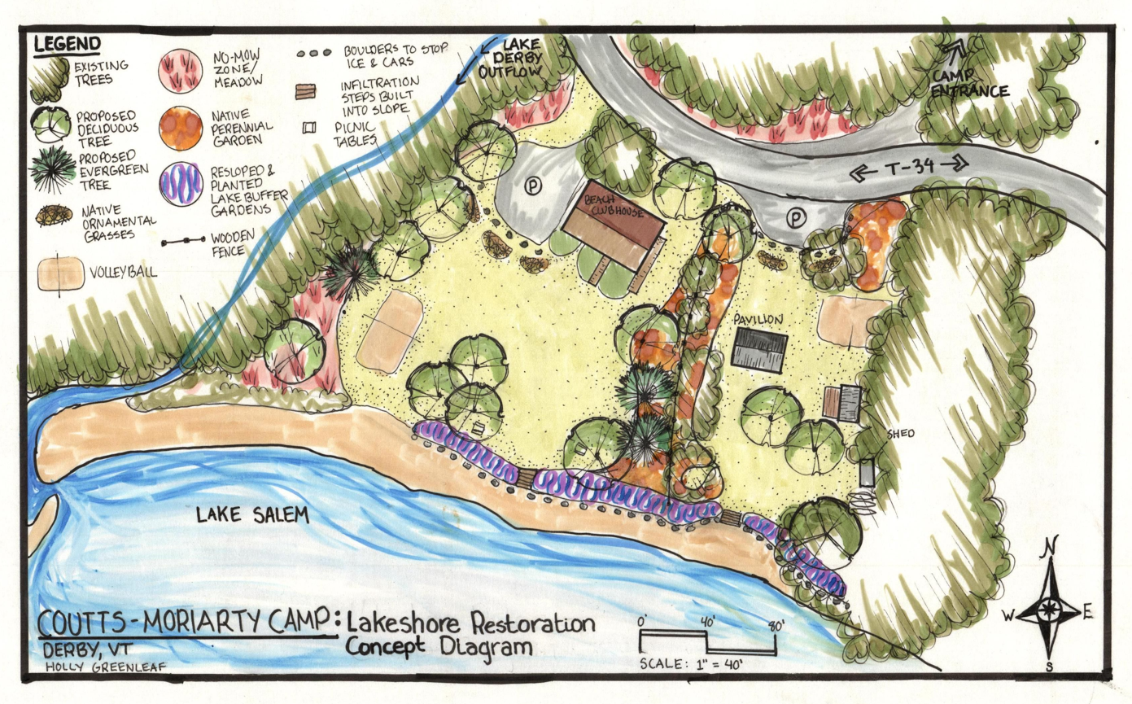
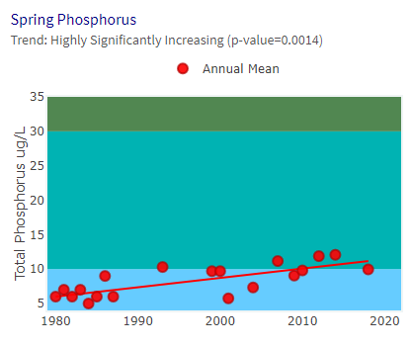
Lakeshore project lifecycle
Lake WQ concern
Lake Watershed Action Plan/ Lake Wise Assessment
Landowner interest confirmed
Lake projects built
Operations and maintainence
Lake projects designed

Slide 4
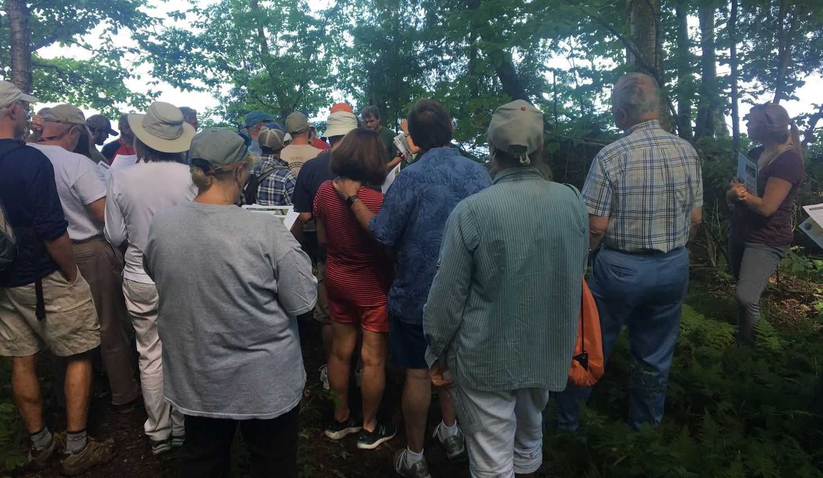
Lakeshore restoration partnerships
Lake Associations
Natural Resources Conservation Districts
Environmental Consultants Engineers & designers
Landscapers Contractors & Work Crews
DEC Lakes and Ponds & Watershed Planning
Lakeshore Property Owners
Watershed organizations

Slide 5
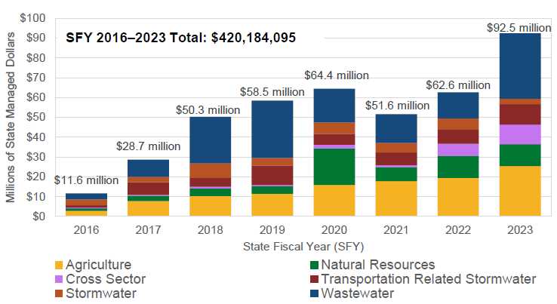
Clean water funding

Slide 6
Lake Watershed Action Plan
A Lake Watershed Action Plan (LWAP) is an assessment to identify the highest nutrient/sediment pollution loading areas from a lake’s watershed that are resulting in water quality and habitat degradation.
The LWAP results in a prioritized list of projects and strategies to address the sources of pollution and habitat degradation identified in the assessment.
Prioritized list of projects can feed into DEC Watershed Projects Database and be considered for Clean Water Funding.

Slide 7
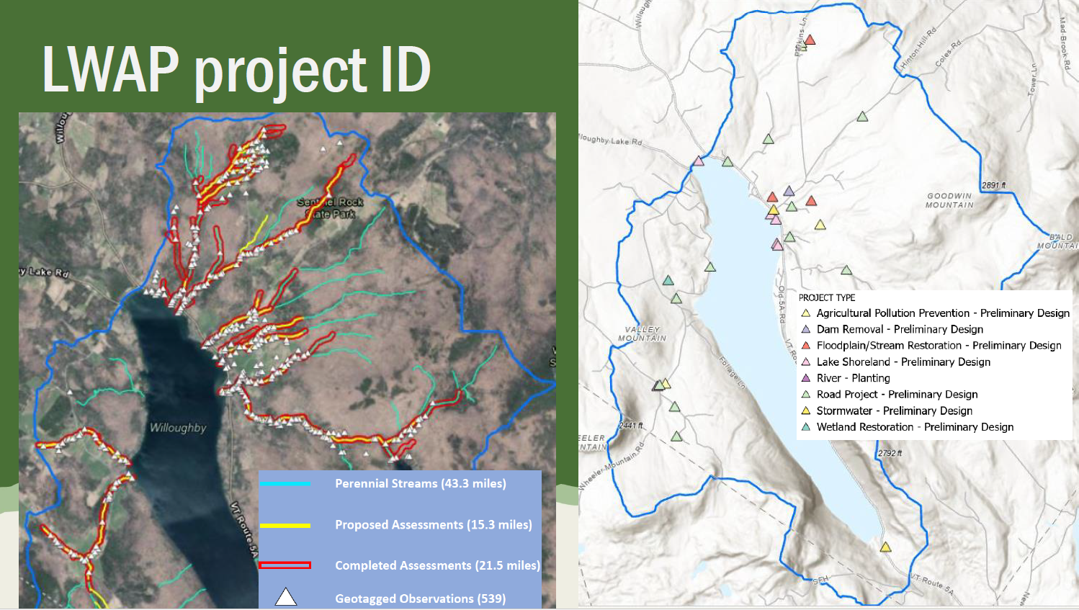

Slide 8
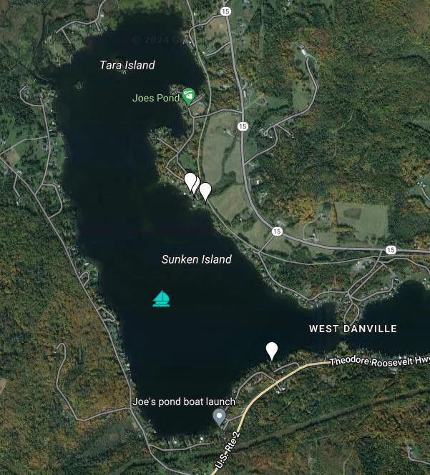
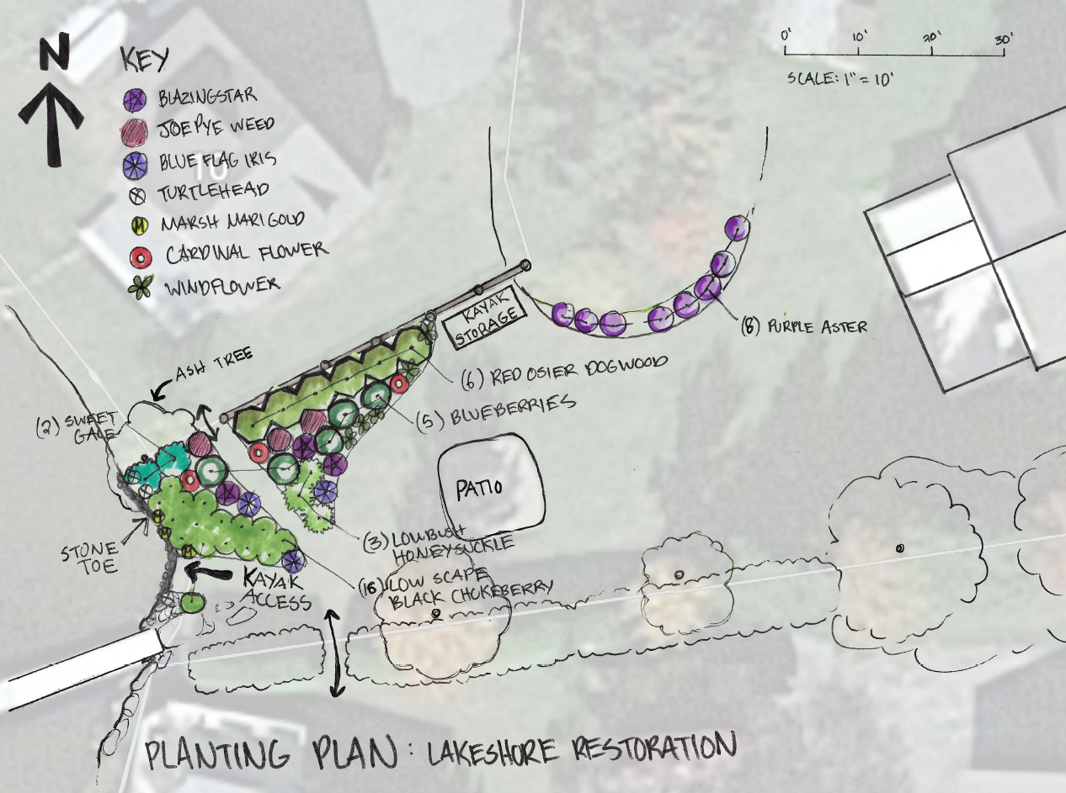
Lake Wise Assessments – Joes Pond

Slide 9
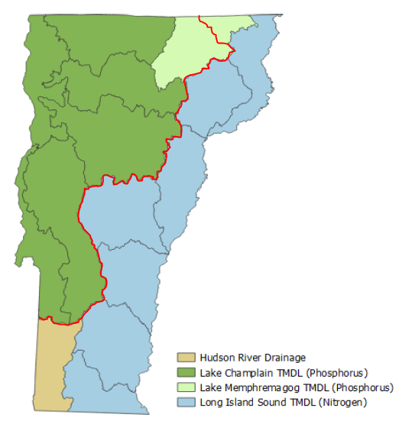
Funding Opportunites for Lakeshore projects
Water Quality Enhancement Grants Connecticut and Hudson Basins or for projects with limited phosphorus reduction potential.
Formula Grants - Lake Champlain & Memphremagog basins for projects with high phosphorus reduction potential.
Notes:
Also, other funding sources are available to support lakeshore restoration projects including LIS futures fund, LCBP funding, Upper Connecticut River M&E funds, Watershed grants…

Slide 10
Project Eligability
Projects need to be added to the Watershed Project Database
Landowner agreements for design and implementation projects
Permitting program approval or indication that the project can be permitted
Project specific requirments
Lake Wise assessments for most lake shoreland projects

Slide 12
Water Quality Enhancement Grants
Funding for LWAPs and Lake Wise assessments prioritized outside of Lake Champlain and Memphremagog watersheds
Project development, design and implementation block grants to:
Watersheds United Vermont
Natural Resources Conservation Council
Mount Ascutney Regional Commission

Slide 13
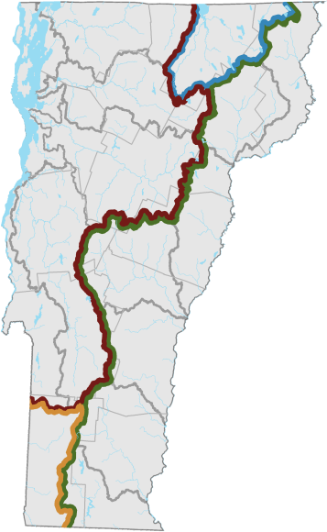
Human resources slide 4
Formula Grants – Phosphorus Reduction Focus
CWSP identify, prioritize, develop, construct, verify, inspect, operate, and maintain clean water projects
BWQCs establish policy and make decisions for the CWSP regarding prioritizing projects that address impairments based on the tactical basin plan
The Clean Water Service Providers (CWSP) shall convene a Basin Water Quality Council
The Basin Water Quality Council (BWQC) will meet quarterly or more frequently to prioritize projects
for design or
implementation.
6
17
NRCD
7
RPC
As the Clean Water Service Provider for the Missisquoi (06) and Lamoille (07) Basins, the NW RPC will service more than one basin. They will convene one council per basin.
Basin Water Quality Council
WS Org
6
5
8
Muni
Cons
Org
3
WS Planner
CWSP- NWRPC
NRCD
NRCD
RPC
RPC
Basin Water Quality Council
2/4
WS Org
CWSP
VHCB
WS Org
Basin &Water Quality Council
7
Muni
Muni
Cons
Org
Cons
Org

Slide 14
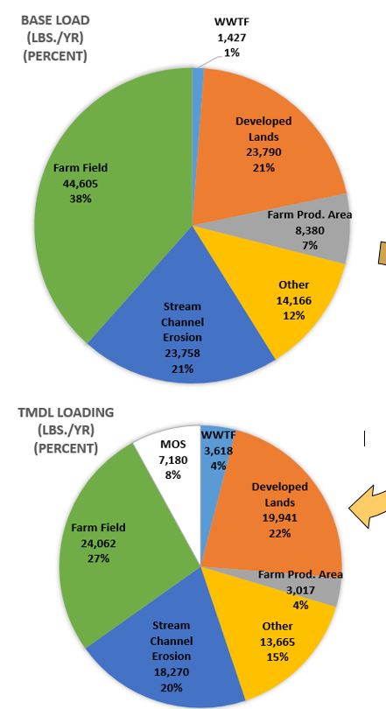
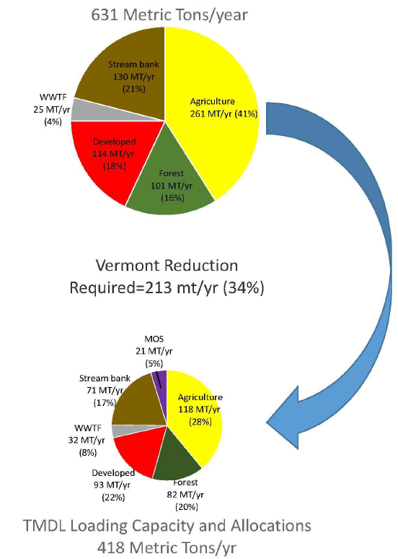
Lake Champlain and Memphremagog TMDLs
Lake Memphremagog Lake Champlain
TMDL’s are a budget that sets target reductions across different phosphorus source areas to meet water quality targets for these lakes.
We track phosphorus load reductions so we can measure progress in meeting targets.
Funding under Act 76 through Clean Water Service Providers is directly tied to phosphorus load reduction targets from the TMDL.
Developed lands make up a substantial portion of the phosphorus loading to both lakes
Reduction
29%
TMDL loading capacity and allocations 418 mt/yr

Slide 15
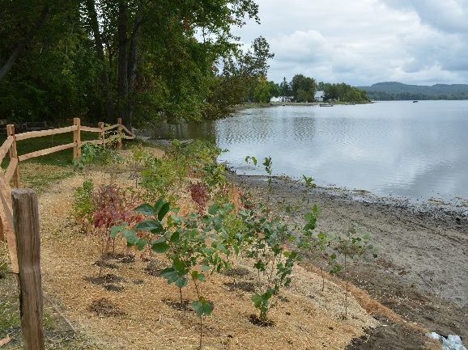
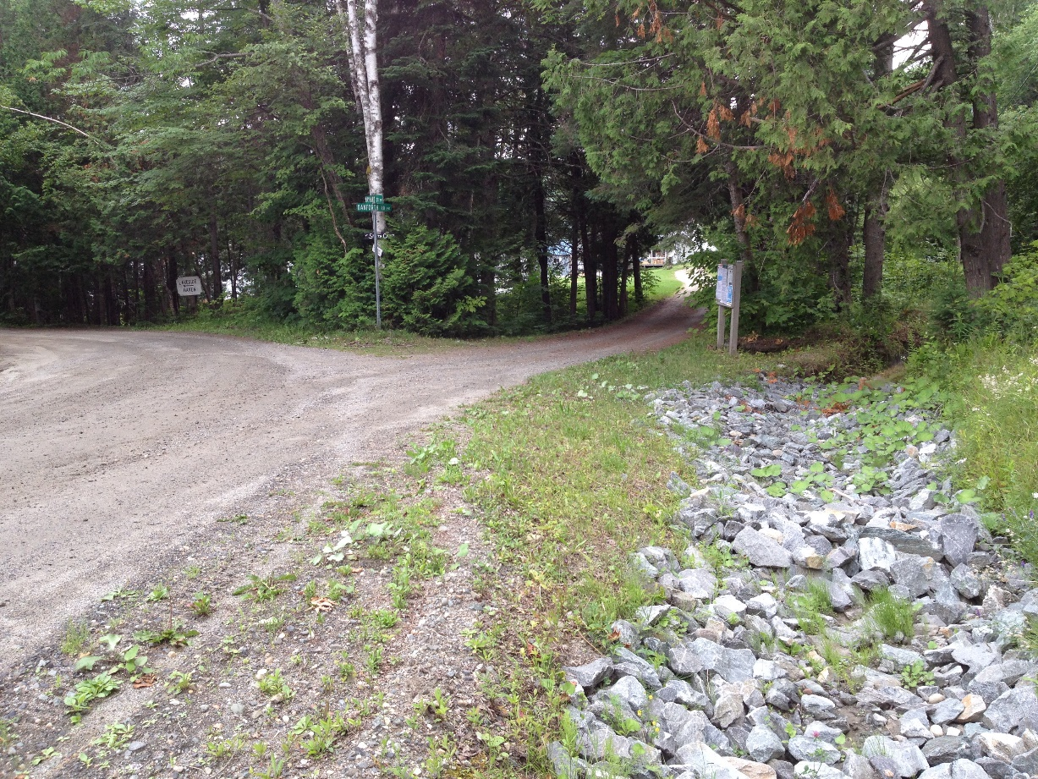
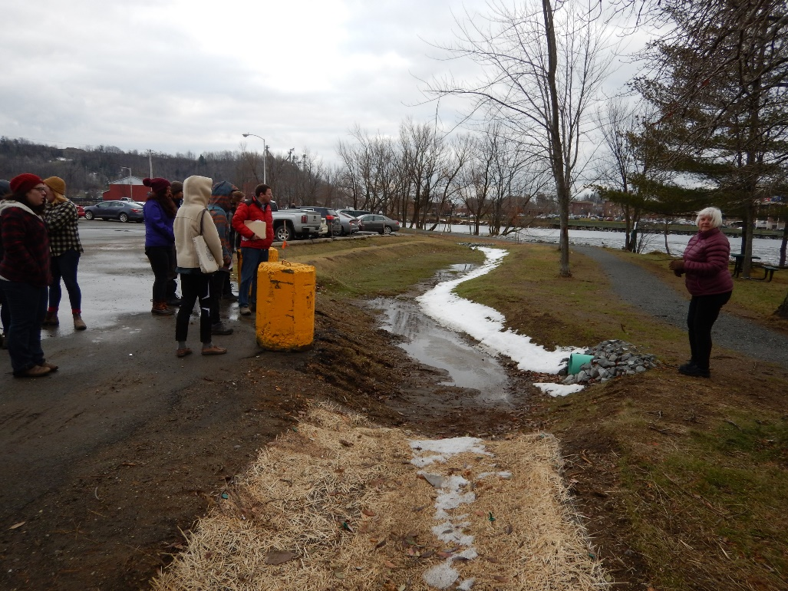
Lake Project types (and phosphorus reduction calculation tools)
Shoreland stabilization & Riparian buffer plantings (interim p calculator)
Private road practices (Private Road Erosion Inventory REI)
Small scale stormwater practices (STP calculator)

Slide 16
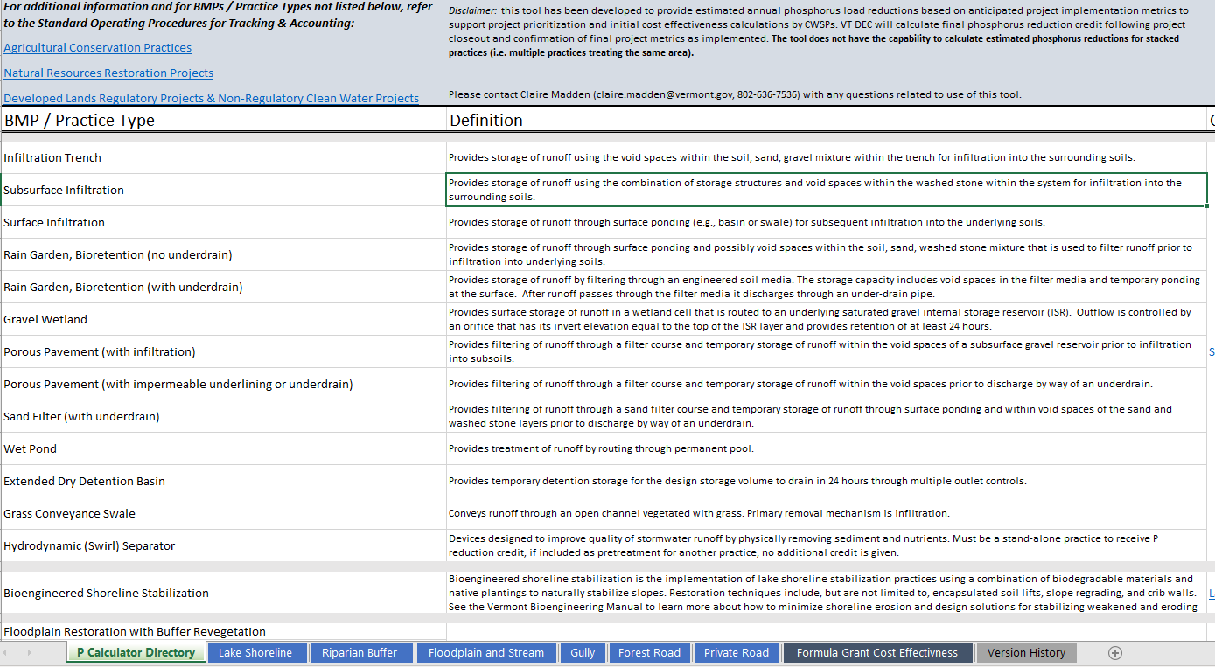
Interim phosphorus reduction calculator tool
Online Trainning available
https://dec.vermont.gov/water-investment/cwi/grants/resources
Notes:
This Interim phosphorus reduction calculator tool calculates the phosphorus reduction of many projects based on approved standard operating procedures for tracking and accounting for Agricultural, developed lands and natural restoration projects.

Slide 17
Lake Shoreline

Slide 18
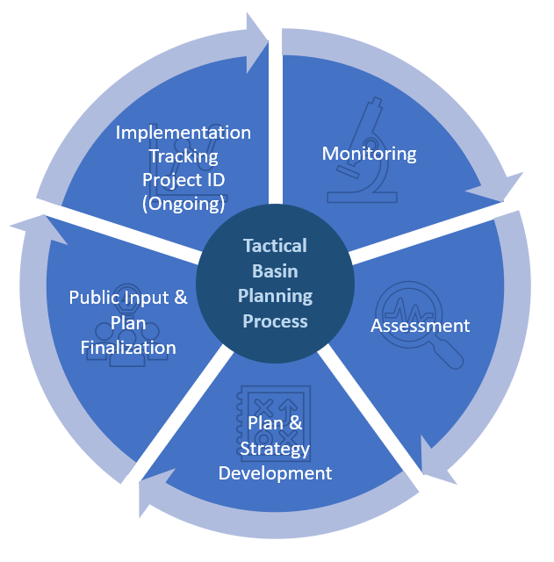
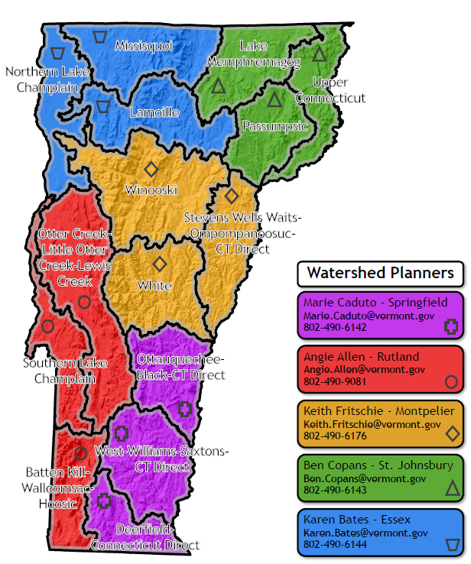
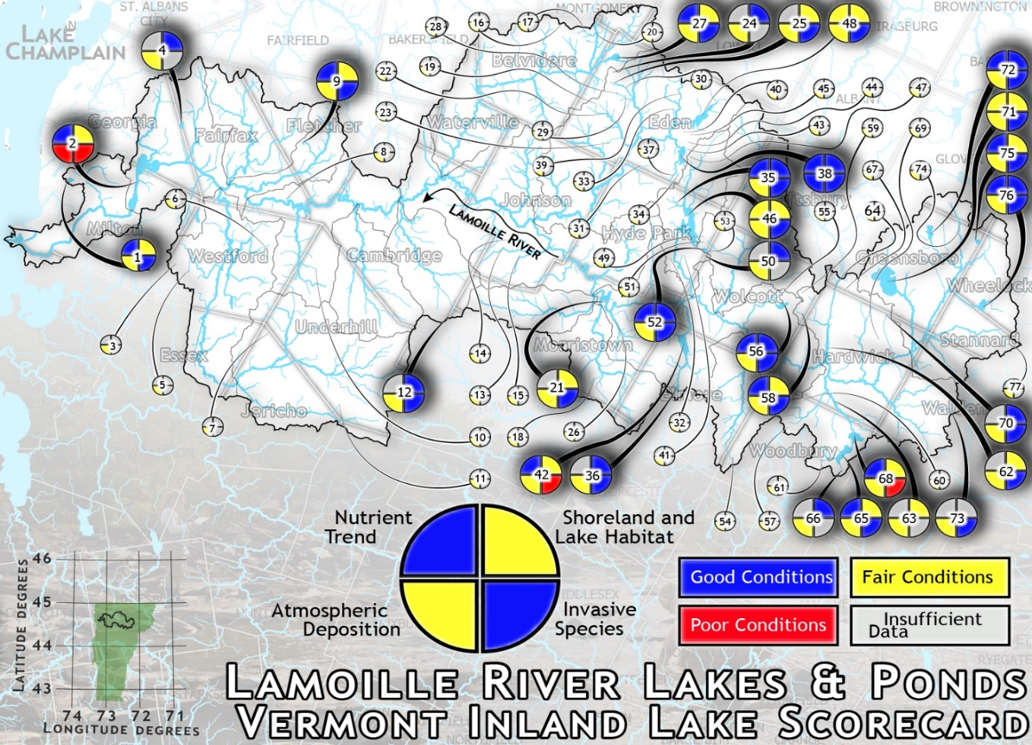
Tactical Basin Planning
Notes:
The Agency produces Tactical Basin Plans for each of the 15 basins across Vermont every 5 years. Tactical Basin Plans identify priority water quality concerns in each basin, as well as those high-quality waters which are a priority for protection. Tactical Basin Plans support the implementation of TMDL’s by identifying priorities projects for implementation including a focus on both Lake and stream watersheds, and identify the lakes where nutrient reduction and shoreline restoration efforts are a priority.

Slide 19
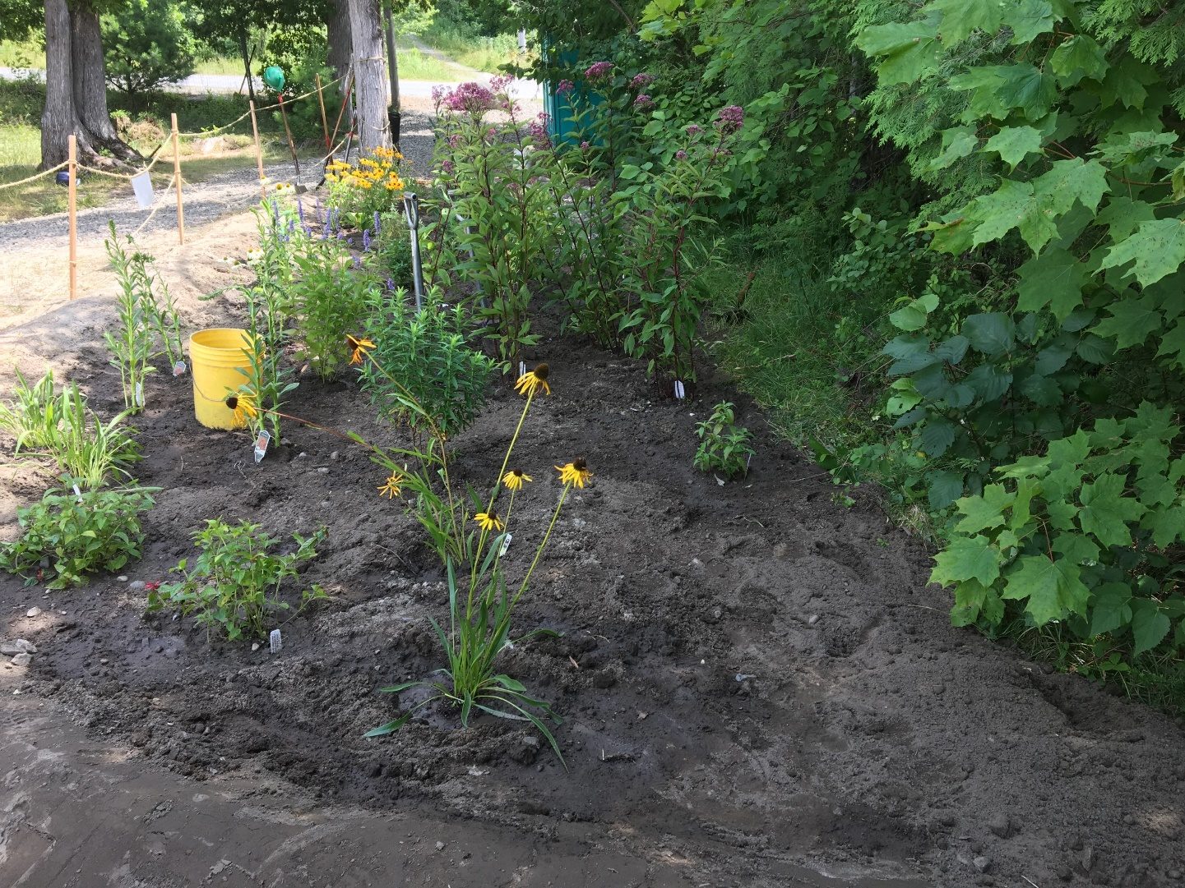
Questions?
Ben Copans- Watershed Planner (802) 490-6143 ben.copans@vermont.gov

Slide 20
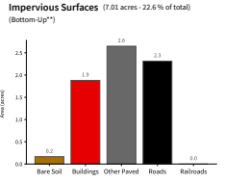
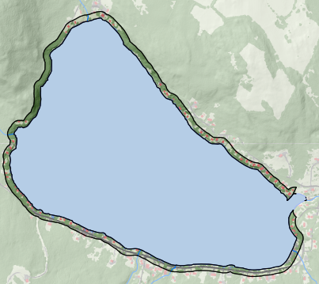
Practices also help to address increasing nutrient trends and to improve lakeshore habitat – Shadow Lake Example….
Land cover
Lake score card

Slide 21
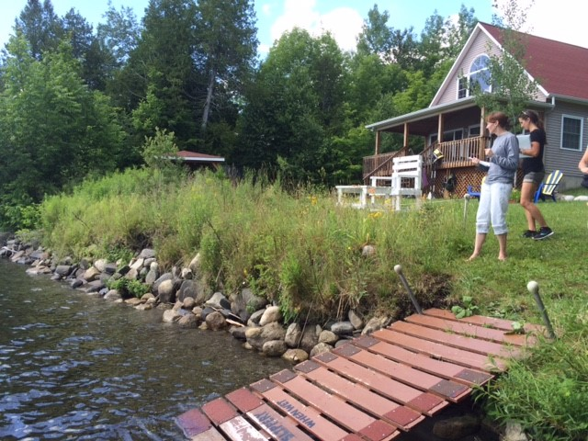
Riparian buffers

Slide 22
Riparian Buffer
Up to three land uses can be included.

Slide 23
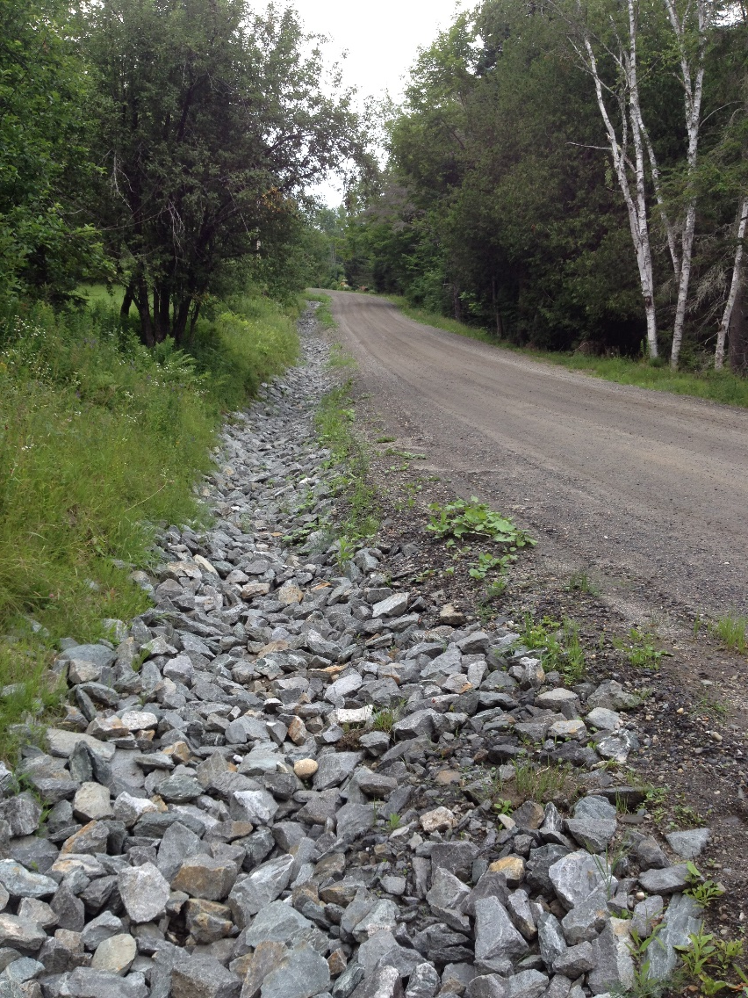
Private Road Projects- tied to

Slide 24
Private roads

Slide 25
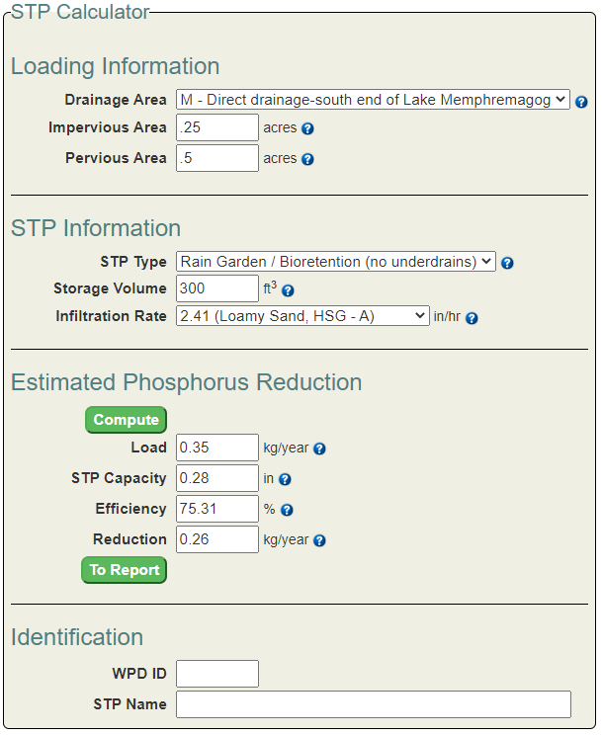
Stormwater projects use the STP calculator to estimate phosphorus reduction potential.
https://anrweb.vt.gov/DEC/CleanWaterDashboard/STPCalculator.aspx

Slide 26
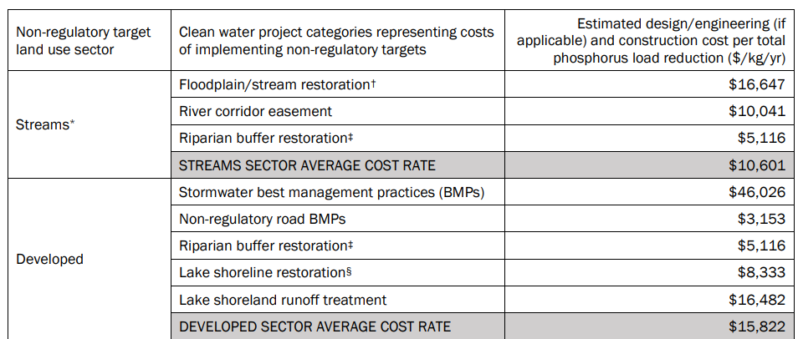
The cost effectiveness tab allows the costs per kilogram to be estimated which can allow you to compare to average costs
Formula grant projects are expected to range in the cost per KG based on project type and individual project costs.

Slide 27
Partnerships are key for many lakeshore restoration projects
Natural Resource Conservation Districts and watershed groups often support Lake Watershed Action planning and Lake Wise assessments and get grants to design and implement projects.
Lake Associations are frequently involved in community outreach and engagement for assessments or projects and sometimes get grants directly.
Designers and engineers play a key role with the design or development of complex projects leading LWAP efforts
Landscapers, contractors and work crews frequently lead project implementation efforts.
DEC – Lakes Program and Watershed Planners can provide technical assistance and guidance for funding opportunites for priority projects.

