Slide 1
Polycyclic Aromatic Hydrocarbons
Polycyclic Aromatic Hydrocarbons (PAHs)
  What are they?
  Where are they?
  How do their presence change the public water construction permitting process?
  Other considerations

Slide 2
What are pahs?
“PAHs [Polycyclic Aromatic Hydrocarbons] are ubiquitous environmental pollutants. They are not only found naturally in the environment but they can also be man made. PAHs are formed as a result of incomplete combustion of carbon-containing materials, such as wood, coal, oil, gas, or biomass. They are also created in car and diesel exhaust, smoked or charbroiled food, and are present in cigarette smoke condensate, and tobacco products.”
M. Huang, T.M. Penning, in Encyclopedia of Food Safety, 2014
A PAH that many of us have heard of is Naphthalene. Naphthalene is a man made PAH used to make mothballs, etc.
Notes:
CDC’s brief explanation on how PAHs affect people’s health – blood and liver problems, some are cancer-causing. March 2022 Fact Sheet, CDC.

Slide 3
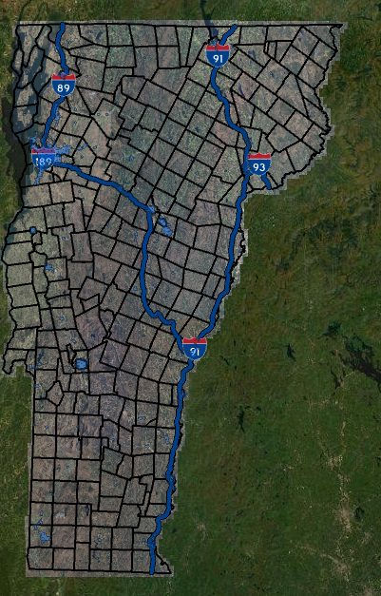




Where are PAHs
Identified releases of hazardous materials to the environment, regulated by Waste Management and Prevention Division.
Urban soils, aka, Development Soils. See the Urban Soil Background Area layer on the ANR Atlas.
More information about this can be found on the Waste Management and Prevention Division’s website at https://dec.vermont.gov/waste-management/contaminated-sites/guidance.
A fact sheet on locating the area of a town where these criteria may apply, and providing a brief description of the mitigation targets: https://dec.vermont.gov/sites/dec/files/wmp/Sites/2019.10.29.development.soils_.factsheet.pdf
The Vermont evaluation of background soils is located at: https://dec.vermont.gov/sites/dec/files/wmp/Sites/4.11.17.TextOnly.Vermont.Soil_.Report.FINAL_.pdf
Screen shot from ANR Atlas 6/13/22. Blue shading = Urban Soil Background Areas. Red circles to draw attention to some of the largest, identified areas in VT.

Slide 4
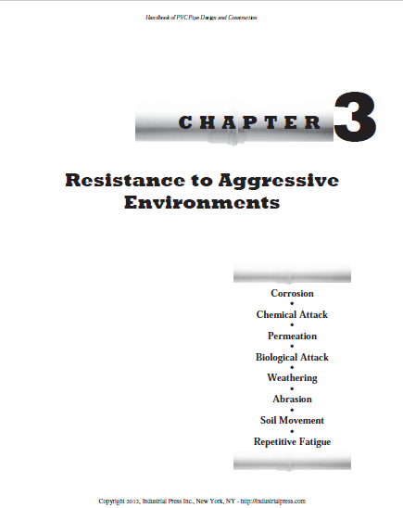
Do pahs affect public water construction permitting
Currently, there are no changes proposed to our public water construction permits.
However,
Appendix A, Subpart 8.0.1 of the Vermont Water Supply Rule states: “Pipe, fittings, valves and fire hydrants shall conform to the latest standards issued by the AWWA.”
ANSI/AWWA Standards C900 through C950; if a water main must pass through an area of gross contamination, the manufacturer must be consulted regarding the permeation of pipe walls and joint fittings prior to selecting the material.
The contaminant matters - Napthalene (PVC not resistant to this), Anthraquinone (PVC generally resistant to this)
Notes:
2015 EPA Study and the Handbook of PVC Pipe Design and Construction primary resources. Examples of PAHs: Napthalene (PVC not resistant to this), Anthraquinone (PVC generally resistant to this). Based on the research we’ve done, and the internal conversations we’ve had with other DEC staff that are more familiar with PAHs, we do not have concerns about background levels (around 580 ppb) of PAHs. Some of the questions we have: where is “gross contamination” defined? How would a contractor/resident engineer/water system staff identify this on a job site?

Slide 5
Other considerations
The health concern with PAHs soils disturbed during construction projects is primarily from direct contact.
The Consultant or subconsultant needs to put together a soil management plan. This plan needs to be reviewed and approved by the Waste Management and Prevention Division. The soil management plan will involve steps to identify and quantify the conditions, to inform work measures, and disposal documentation.
Project development must allow the necessary timeframe for identification of conditions, prior to excavation, that can be interrupted by unplanned discovery of condition requiring regulatory oversight.
This work should be considered during the Preliminary Engineering phase of the project.

Slide 6
Your experiences
Wayne Elliott, PE, President of Aldrich + Elliott, PC

