Slide 1
Engaging the Public in the Budget Process
Access materials online
Visit the Clean Water Board webpage: dec.vermont.gov/water-investment/cwi/board
Join the Clean Water Stakeholders Listserv: tinyurl.com/87s7tjse
Review available materials 1) Background: Clean Water StoryMap
2) SFY 2026 At a Glance:
Two-Pager
Plain Language Budget Table
3) SFY 2026 Deep Dive:
Budget Table
Policy Document
Line-Item summary recordings
Feedback
Via online questionnaire
Via written submission: anr.cleanwatervt@vermont.gov
At Public Hearing
Public Comment Period: October 18, 2024 - November 17, 2024
Public Hearing: November 8, 2024
Clean Water Board consideration of public comment: December 3, 2024
Notes:
Many ways to participate in the clean water budget process
First, take note of these important dates
Stay
Allow the public to Review the Resources their Way:
Draft Clean Water Budget (PDF) – Budget and line-item numbers broken down across base and one time funding
Clean Water Budget Overview (PDF) – Background of CWB process and written description of budget line items
Story Map - Background of CWB process and video recordings describing budget line items
Plain language budget table – a breakdown of what each line item is funding
Want to hear thoughts from the public in the following ways:
Comment via online questionnaire
Comment at Public Hearing – won’t be a presentation – watch videos or review materials in advance
Comment via written submission

Slide 2
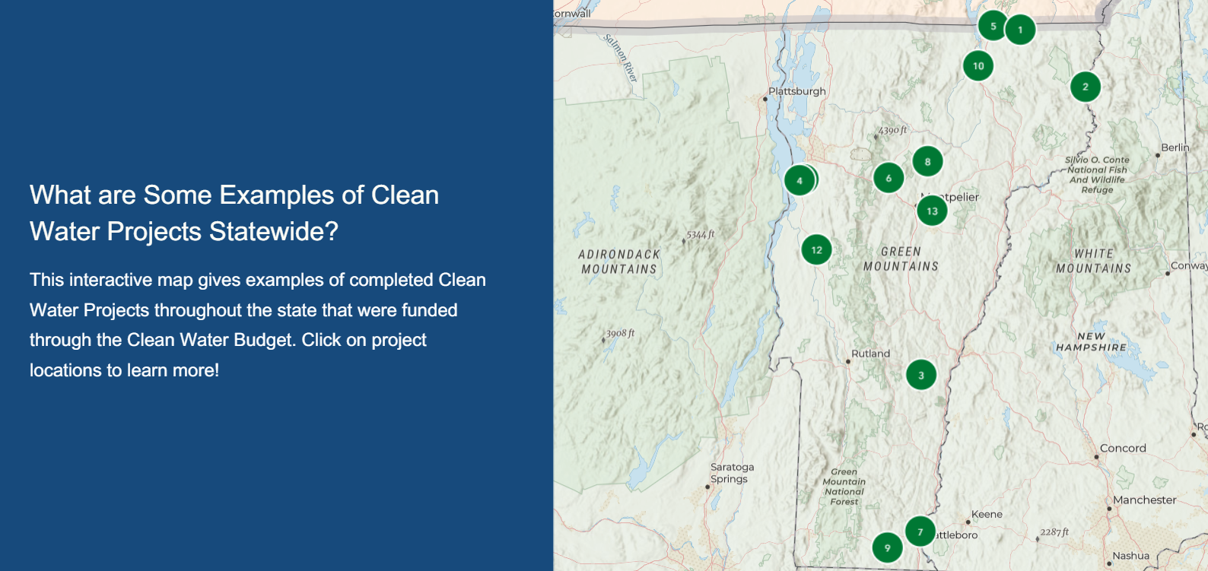
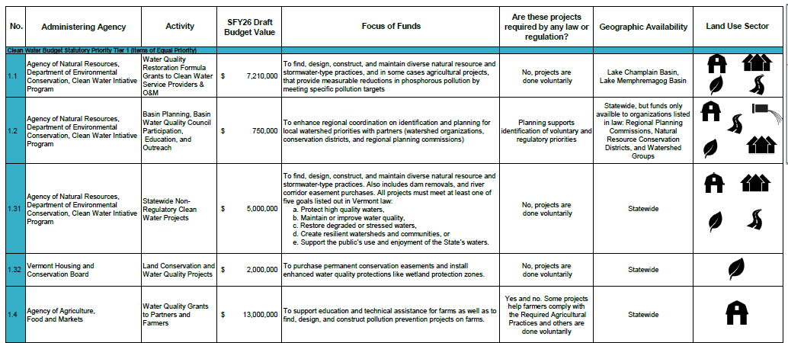
SFY 2026 Communications Improvements
Screenshot of Clean Water Board and Budget StoryMap
Plain Language Clean Water Budget Table
Notes:
Due to a decline in public participation over the last few years, we have created some additional communications aimed at getting the public more involved. These new communications resources are focused on plain language to make the budget easier to understand and comment on for the public. These resources are:
1. An updated storymap that walks the reader through The Clean Water Board, the budget cycle, successful project examples, and the general state of water quality in Vermont
2. A Plain Language Budget Table – which breaks down each line of the budget table to make it easier to understand what it being funded
3. A handout packet to support these other materials which describes the Board and Budget Process for the public
We also obtained feedback that people may not be aware of the Clean Water Budget Process and have been working with the interagency group to expand our reach by utilizing existing events and meetings as a place to discuss the importance of the Clean Water Board Public Comment Period.

Slide 3
Notes:
There has been an increase in public participation from last yr, but this coming year the CWIP team will continue to implement new communications improvements to continue on this trajectory

Slide 4
Why questionnaire respondents chose to participate in the process:
Environmental concerns: including the adverse effect that cyanobacteria blooms have on recreation and tourism and worries about the timeliness of clean water action in Vermont.
Equity considerations: like the equal distribution of clean water funds across the state and the negative impact of regulatory requirements on low-income Vermonters.
Project implementation: Participants commented that they have seen bottlenecks in project completion due to lack of funds and that money should be going toward the best implementation projects.
Public support: Respondents commented that they chose to answer the questionnaire to inform the state of local needs and to show public concern.
3-acre program/stormwater concerns: including residents’ inability to pay for new regulatory stormwater infrastructure.
Notes:
Due to a decline in public participation over the last few years, we have created some additional communications aimed at getting the public more involved. These new communications resources are focused on plain language to make the budget easier to understand and comment on for the public. These resources are:
1. An updated storymap that walks the reader through The Clean Water Board, the budget cycle, successful project examples, and the general state of water quality in Vermont
2. A Plain Language Budget Table – which breaks down each line of the budget table to make it easier to understand what it being funded
3. A handout packet to support these other materials which describes the Board and Budget Process for the public
We also obtained feedback that people may not be aware of the Clean Water Budget Process and have been working with the interagency group to expand our reach by utilizing existing events and meetings as a place to discuss the importance of the Clean Water Board Public Comment Period.

