Slide 1
Public Hearing on the Amendment of Ch. 4 Pollution Abatement Facility Operator Rule
March 9, 2021
4-6pm
David Domenico
Katelyn Ellermann
Bryan Harrington
Amy Polaczyk
https://dec.vermont.gov/watershed/wastewater/rulemaking

Slide 2
Agenda
Welcome and Rule Making Overview
Katelyn Ellermann, DEC Associate General Counsel
Overview of Amendment of Ch. 4 Pollution Abatement Facility Operator Rule
Amy Polaczyk, Wastewater Program Manager
Questions and Comments
This session is being recorded. Please state your name and affiliation when commenting or posing questions.
DEADLINE FOR COMMENTS IS MARCH 23, 2021
Submit comments to amy.polaczyk@vermont.gov

Slide 3
Amendment of Ch. 4 Pollution Abatement Facility Operator Rule
First Operator Rule - 1974
Established the minimum experience required to be a wastewater treatment facility operator, grades and types of operator certifications, education requirements over a license period, and brief criteria to determine the class of a domestic or industrial wastewater treatment facility.
Updated 1985
2014
Incorporated stakeholder involvement
Classification Rating system that allocated points for specific treatment processes added. All aspects of the wastewater treatment facility are scored, with the total points corresponding to a facility class.
January 2017
The Legislature designated the Secretary of State’s Office of Professional Regulation (OPR) as the authority for licensing “pollution abatement facility” operators in Vermont. 26 V.S.A., Chapter 99.
Rule under revision since late 2016
Number of facilities affected:
25 Under jurisdiction of the Indirect Discharge Program.
Of these 8 facilities employ operators on a full-time basis.
The rest are part-time or contract basis.
Under jurisdiction of Wastewater Management Program:
1 Domestic | 19
1 Industrial Dairy | 6
1 Industrial Metals | 2
2 Domestic | 47
2 Industrial Dairy | 6
2 Industrial Metals | 7
2 Industrial Paper | 2
3 Domestic | 16
4 Domestic | 8
4 Industrial Dairy | 1
4 Industrial Paper | 2
5 Domestic | 6
Not Required | 98
Grand Total | 220

Slide 4
Notable changes in proposed amendment:
Removed the DEC licensing framework.
Provides additional guidelines for adequate facility staffing. The Wastewater Program believes this is a necessary addition based on recent experience with facilities reducing staff due to budgetary constraints.
Absent a different recommendation by the Department, facility owners should refer to the New England Interstate Water Pollution Control Commission (NEIWPCC) publication “The Northeast Guide for Estimating Staffing at Publicly and Privately-Owned Wastewater Treatment Plants,” as it may from time to time be modified or retitled, in determining adequate staffing levels.
Specifies expectations of Part-time coverage by a chief operator for wastewater treatment facilities.
Chief operator must be on-site at the wastewater treatment facility a minimum of 8 hours per week and available to make day-to-day process decisions and respond to emergencies.
The Department may require a chief operator to be on-site for more than 8 hours per week, based on the type, complexity, or permitted flow of the facility, or as otherwise determined by the Department based on the facility’s needs.
If the wastewater treatment facility is not normally staffed full time, the chief operator must be on-site a minimum of 4 hours per week and available to make day-to-day process decisions and respond to emergencies.

Slide 5
Notable changes in proposed amendment (continued):
Recognition that in specified circumstances with written DEC approval, an industrial dairy or metal facility may employ a domestic-licensed operator rather than an industrial-licensed operator.
Update to the facility classification tables. These are not expected to make a difference in classification of currently regulated facilities.
Increase of points needed to require a Grade I operator at Industrial Dairy and Industrial Metal facilities from 0 to 10, codifying current DEC practice.
Recognition that on a case-by-case basis, DEC may make a permitting determination that a low-tech industrial facility does not require a licensed operator. The Wastewater Program does not believe a licensed operator is required where facilities that do not treat process wastewater.
Added Metals Precip to Primary Treatment (5 pts), Trickling Filter (5 pts) to Secondary Treatment, MBR and MBBR to Advanced Treatment (10 pts each), Electrical Generation using Digester Gas (10 pts).
Max points increased from 35 to 40 for Secondary Treatment category.
Final Treatment and Disposal Section (applies only to Indirect Discharge Systems).

Slide 6
Questions and Comments
All comments due by March 23 to amy.polaczyk@vermont.gov

Slide 7
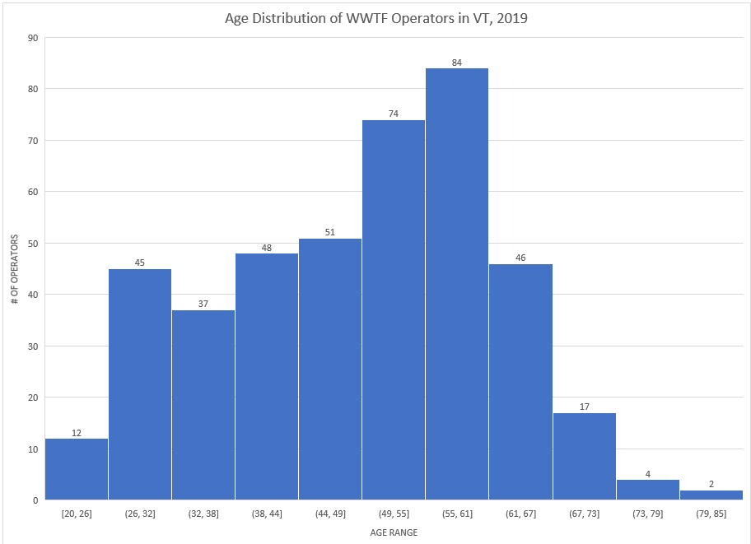
Amendment of Ch. 4 Pollution Abatement Facility Operator Rule
420 Certified Operators as of December 2019
>150 are age 55 or older
More than 1/3 of operators could retire in the coming decade

