Slide 1
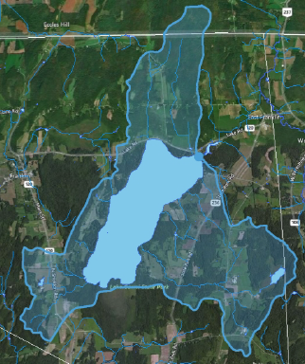

Slide 2
Lake Carmi Phosphorus TMDL Review
January 2018
Mark Mitchell, Lake Assessment Coordinator
VT Department of Environmental Conservation
Watershed Management Division

Slide 3
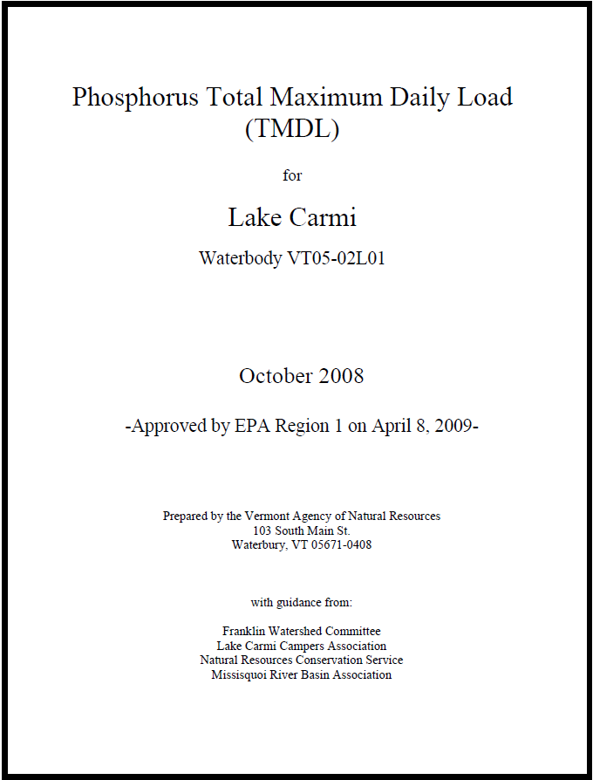
1. What is a TMDL and is Lake Carmi’s Still Useful?

Slide 4

2. What is a TMDL?
Current
Pollution
Load
Necessary
Pollution
Reduction
WQS
Total
Maximum
Daily
Load

Slide 5
3. What is a TMDL?
Establishes a loading target - Science
Sets up implementation plan - Policy

Slide 6
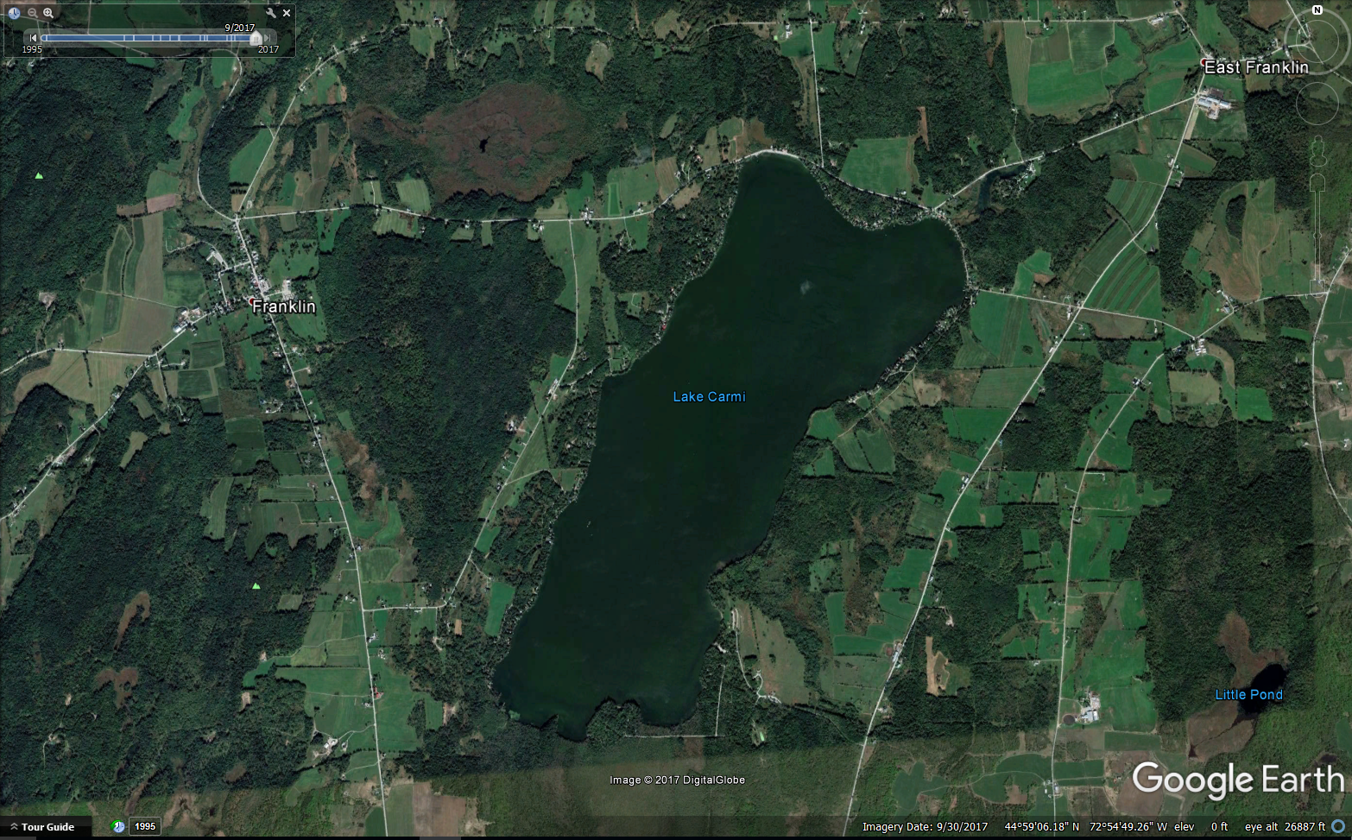
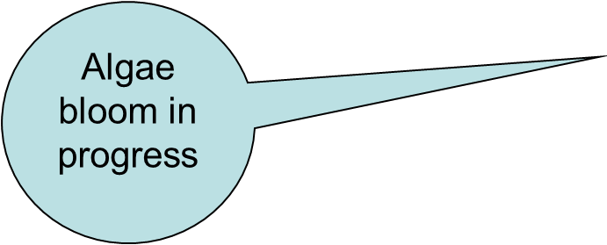
4. What are the pollution issues at Lake Carmi?

Slide 7
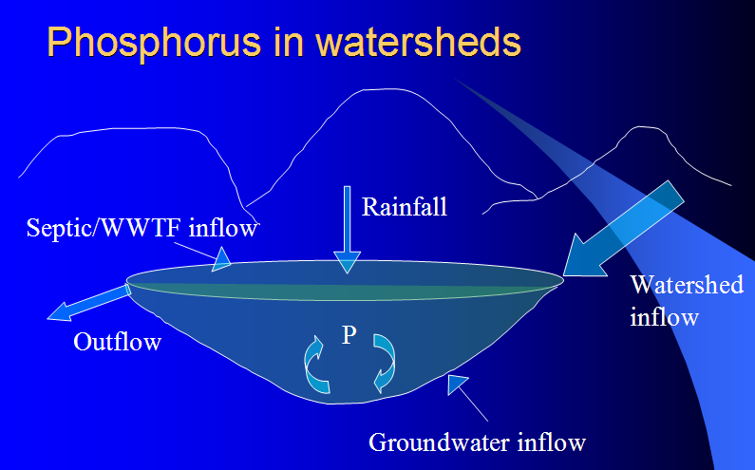
5. What are the pollution issues at Lake Carmi?
Target in-lake total phosphorus concentration is 22 ppb based on best three years of Lay Monitoring data (1994, 1997, 1998).

Slide 8
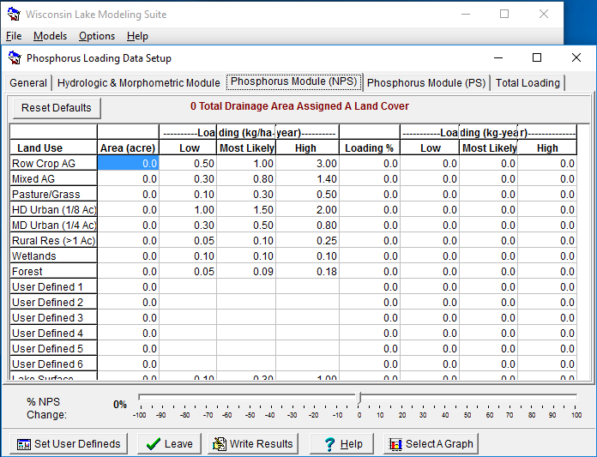
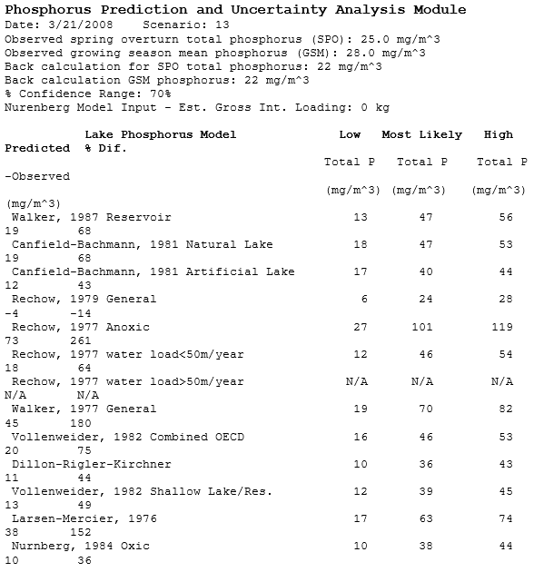
6. How did the TMDL estimate phosphorus entering the lake and from what sectors?

Slide 9
7. How did the TMDL estimate phosphorus entering the lake and from what sectors?
Estimated annual phosphorus loads (kg) Lake Carmi, with breakout of loads from the watershed

Slide 10
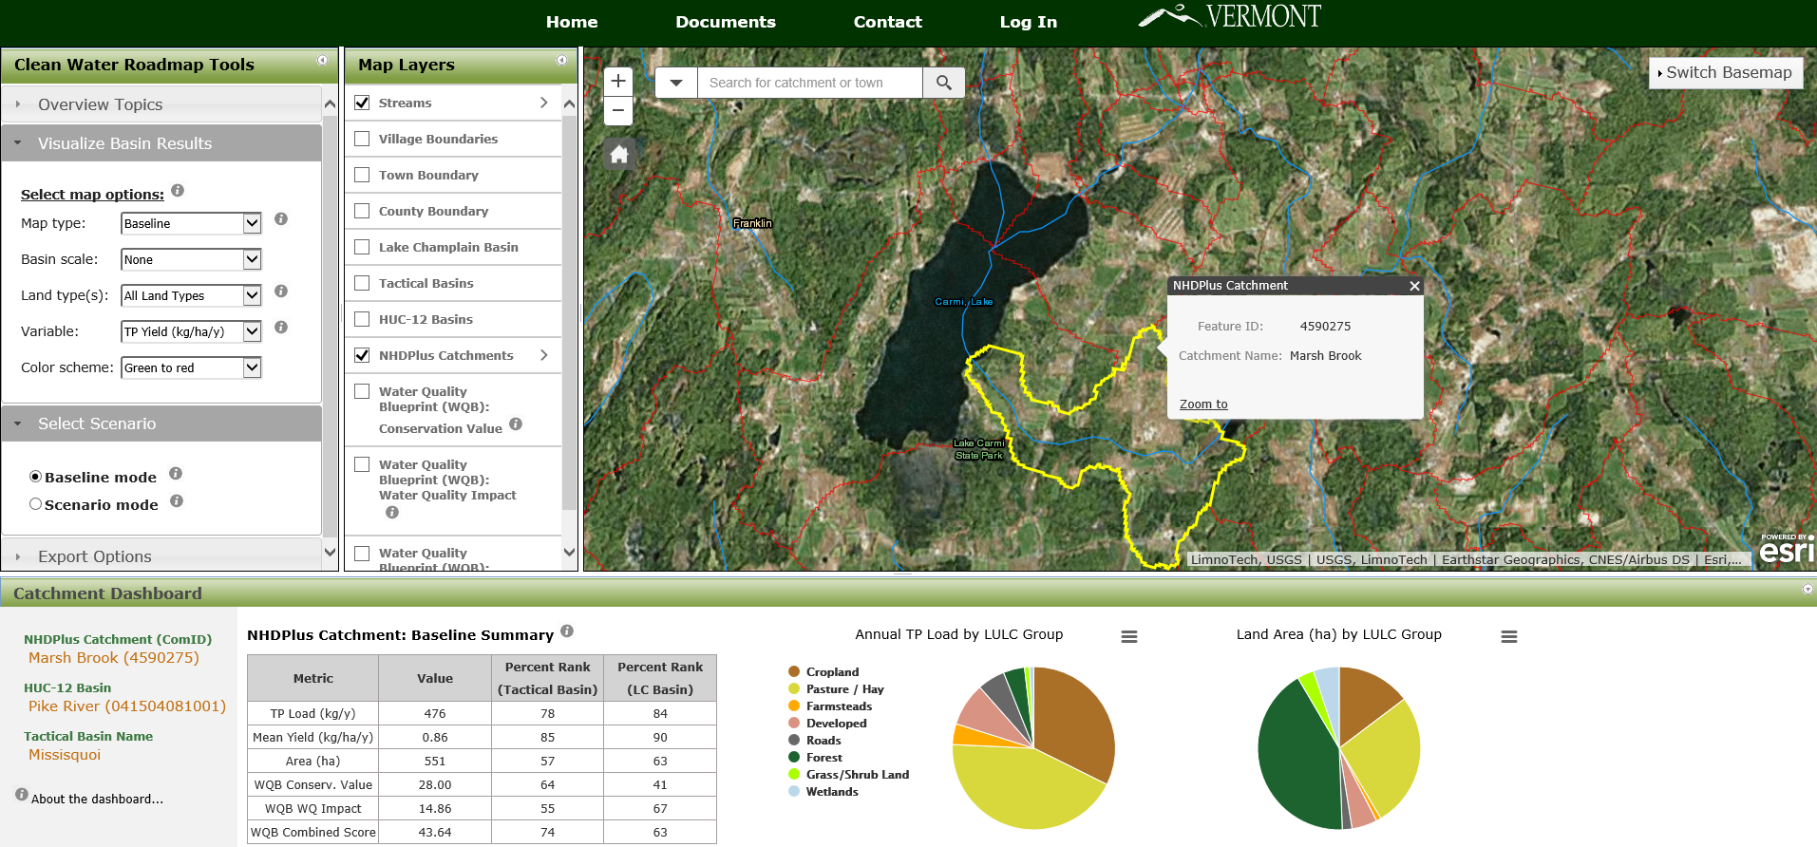
8. Using a new tool to compare watershed loading.

Slide 11
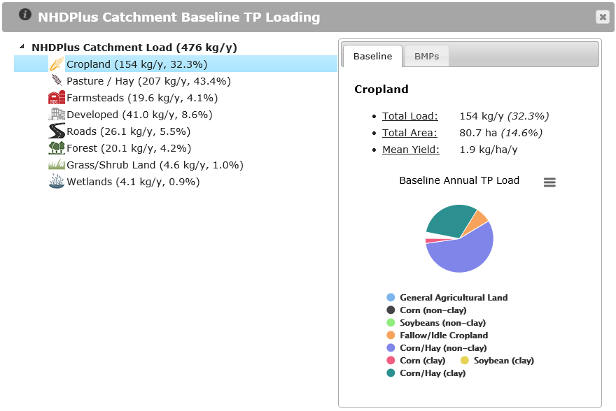
9. Using a new tool to compare watershed loading.

Slide 12
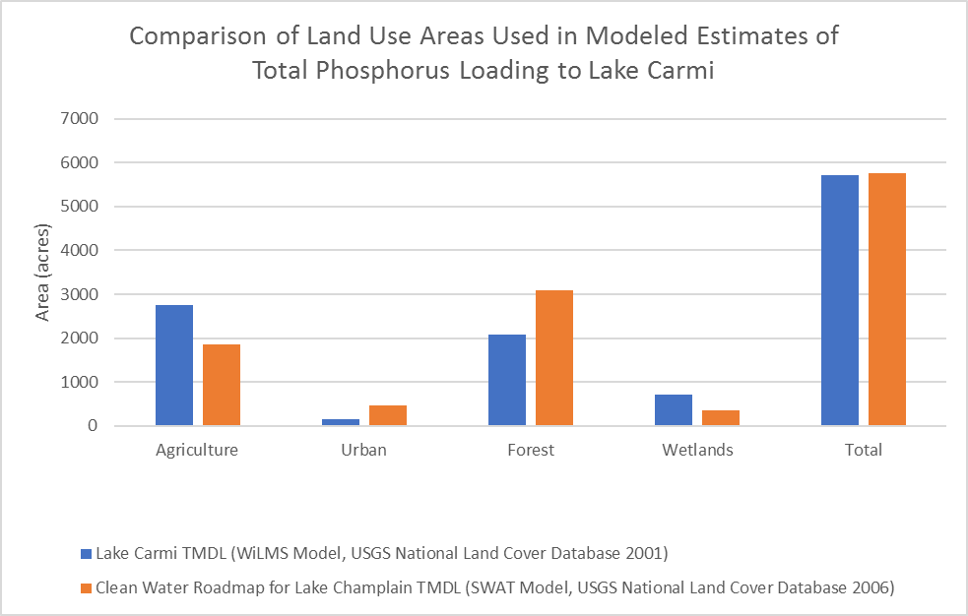
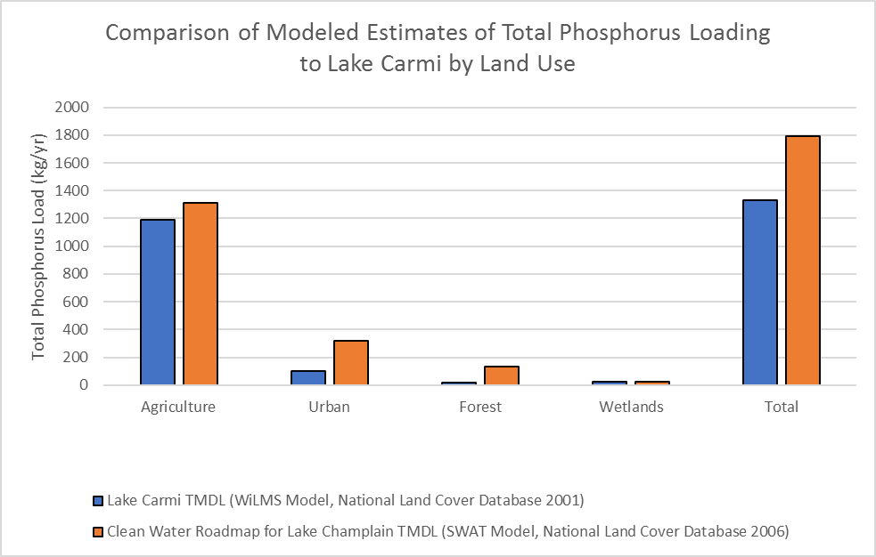
10. What assumptions went into the Lake Carmi TMDL? Modeled estimates used best available data.
Load estimates corroborated with VT Clean Water Roadmap.

Slide 13
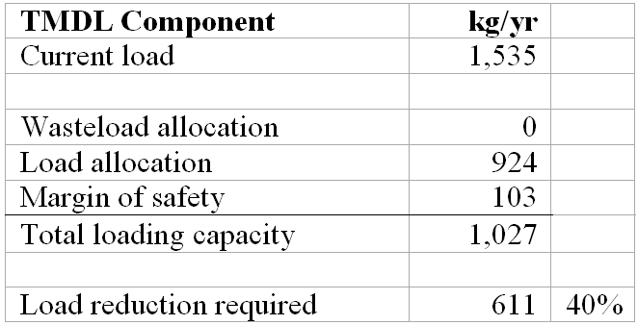
11. How did we account for uncertainty in the development of the TMDL?

Slide 14
12. How are projects being implemented to meet the TMDL?
Act 64 Regulations & Missisquoi Bay Tactical Basin Plan
  Roads
  Other developed landscapes
  Septic Systems
  Natural resource restoration
  Agriculture
With local, state and federal technical and financial resources
Internal phosphorus loads are being addressed by contractor

Slide 15
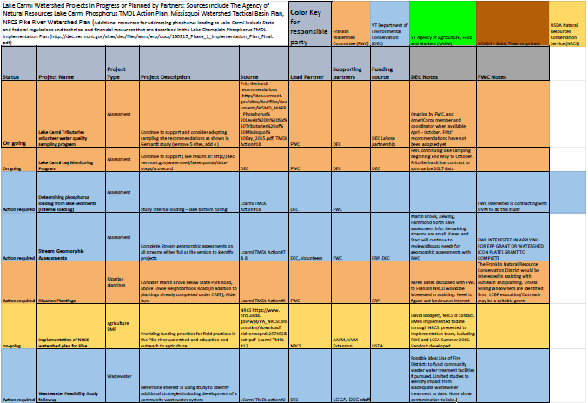
14. Lake Carmi TMDL Action Plan

Slide 16
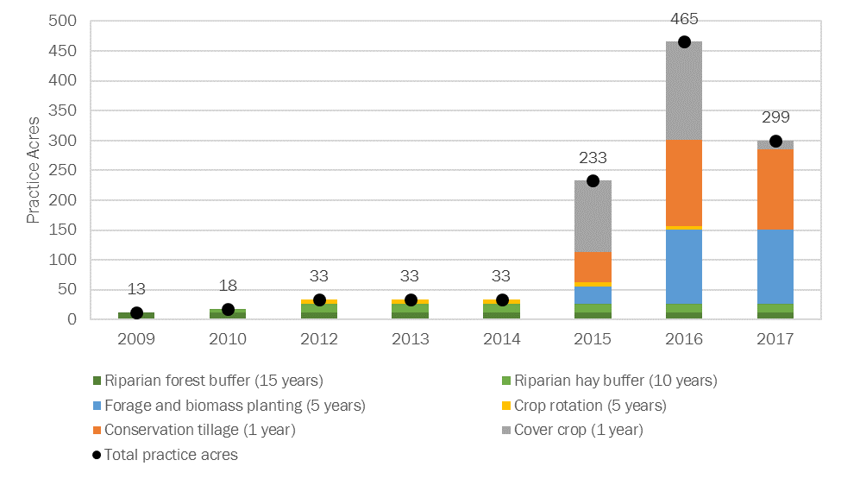
15. Estimated total acres of agricultural conservation practices implemented on crop/pasture fields in the Lake Carmi watershed with AAFM and USDA-NRCS funding.

Slide 17
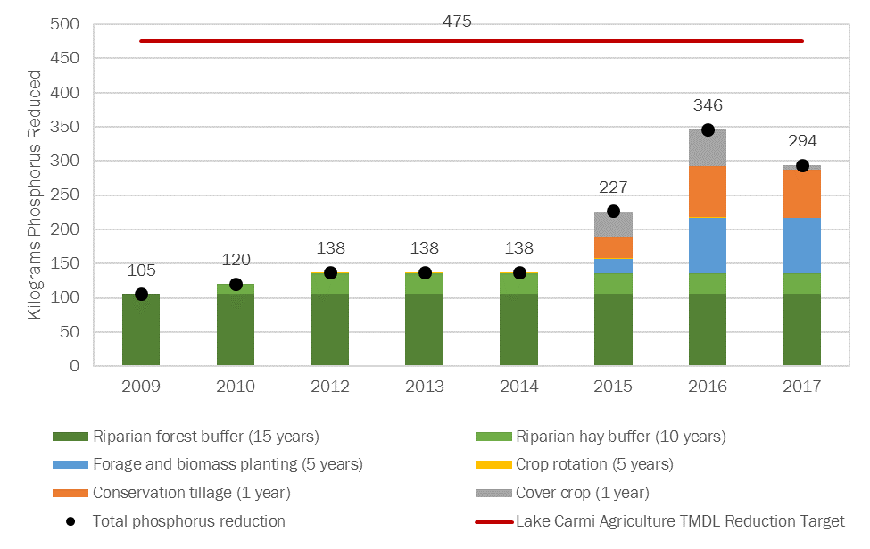
16. Estimated total phosphorus pollution reduced by agricultural conservation practices implemented on crop/pasture fields in the Lake Carmi watershed with AAFM and USDA-NRCS funding.

Slide 18
Thank you! dec.vermont.gov/watershed/cwi/restoring/carmi

