Slide 1
Methodology Matters - Modifying the Vermont Lay Monitoring Program to Improve Lake Assessment
Mark Mitchell (He/him) | limnologist
Lake Monitoring and Community Outreach Coordinator
Lake Champlain Sea Grant and VT Department of Environmental Conservation

Slide 2
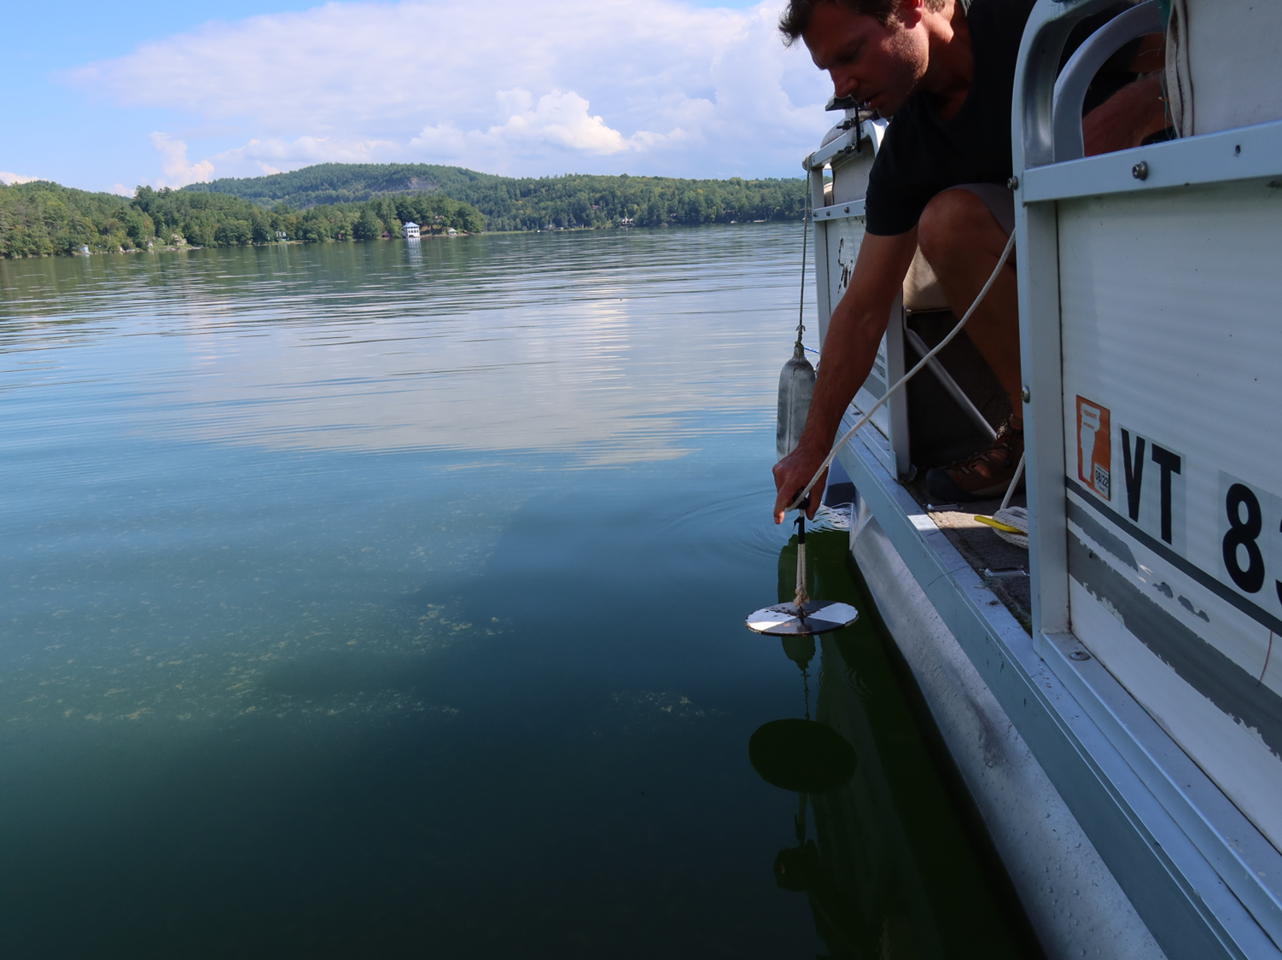
Presentation Outline
Overview of VT Lakes Lay Monitoring Program (LMP)
LMP Data, Reporting and Assessment
2022 LMP Sampling Methodology Pilot Study
Analyses, Summary and Next Steps for 2023

Slide 3
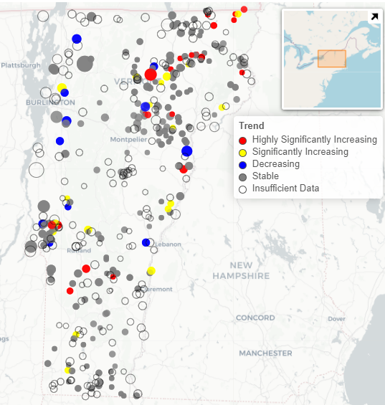
LMP Goals
Equip volunteers (Lay Monitors) to conduct periodic lake water quality sampling from their boat using quality-assured methods
Establish baseline water quality conditions in VT lakes (summer)
Track long-term nutrient trends in VT lakes and assess monitoring data for compliance with VT Water Quality Standards
Educate lakeshore homeowners and lake users about lake ecology and stewardship
(Spring Total Phosphorus)
https://dec.vermont.gov/watershed/lakes-ponds/monitor/lay-monitoring

Slide 4
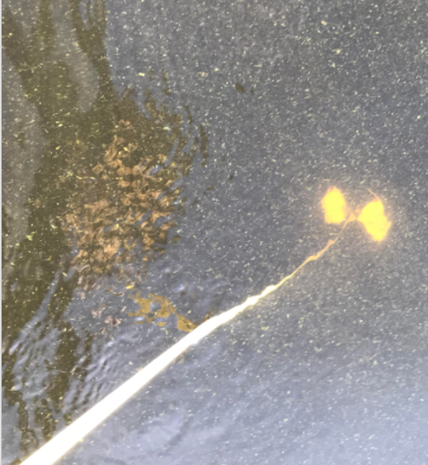
LMP Sampling Overview: 1979-2022
Weekly from Memorial Day to Labor Day (minimum of 8 samples for summer mean):
Basic Sampling: Measure Secchi disk transparency depth (clarity)
Supplemental Sampling: Collect water samples with depth-integrated hose at twice Secchi depth that are lab tested for total phosphorus (nutrient) concentration and chlorophyll-a (algae) concentration
Complete a lake sampling form and user perception survey (algal observations)

Slide 5
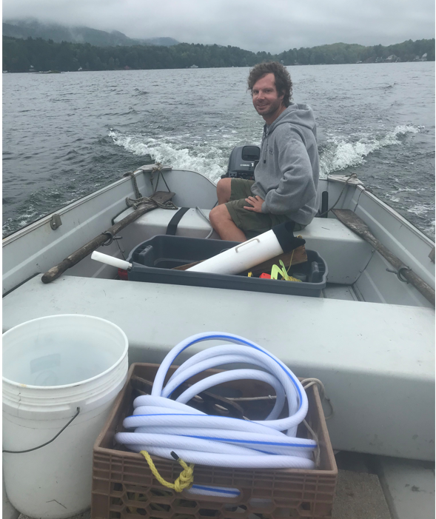
LMP Staff Responsibilities
Equipping and training new Lay Monitors
Quality Control (QC) sampling with Lay Monitors once each summer (ideally)
Picking up samples and logging them into the lab bi-weekly for testing
Answering questions on sampling, lake ecology and management
Processing and analyzing data, preparing annual reports and assessments
Quality Assurance Project Plan (QAPP)

Slide 6
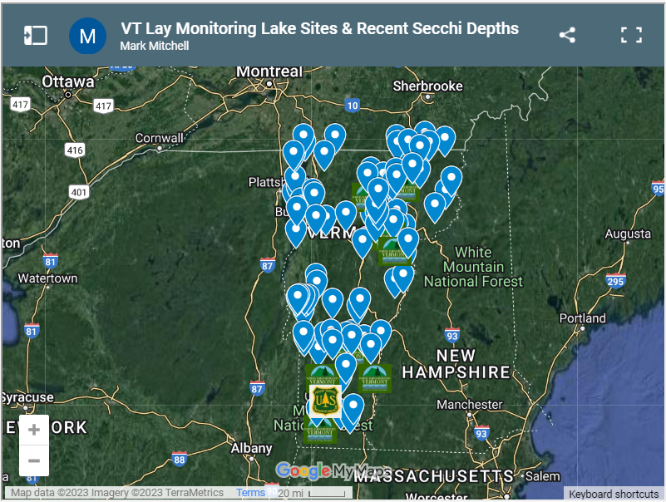
LMP Operates Statewide
In 2022, 83 inland lakes and 8 Lake Champlain stations were sampled by Lay Monitors
66 lakes were sampled for chlorophyll-a and/or total phosphorus
45 lakes were visited by LMP staff for training and/or QC sampling, including water quality vertical profiles

Slide 7
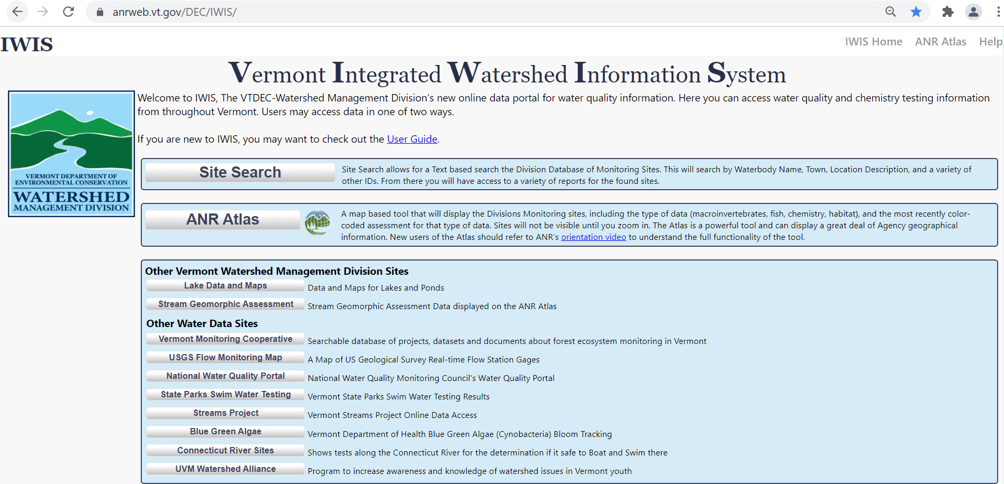
LMP Data/Reports Accessible on LMP Website and WSMD Data Portal (IWIS)
https://dec.vermont.gov/watershed/lakes-ponds/monitor/lay-monitoring#Reports
https://anrweb.vt.gov/DEC/IWIS/

Slide 8
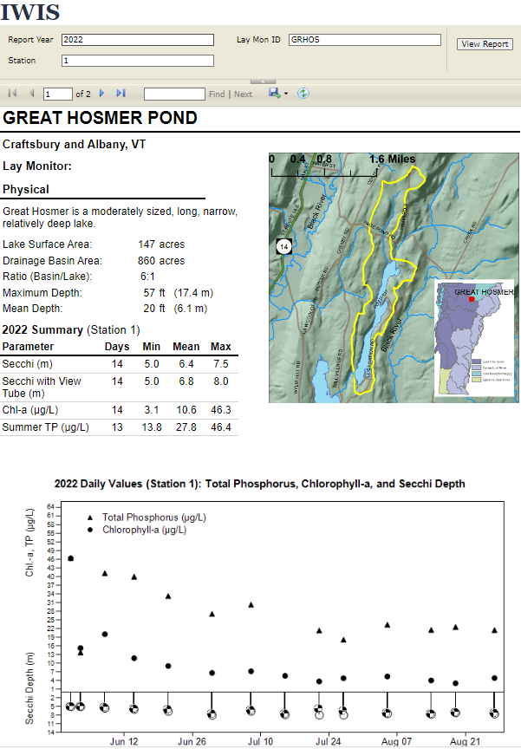
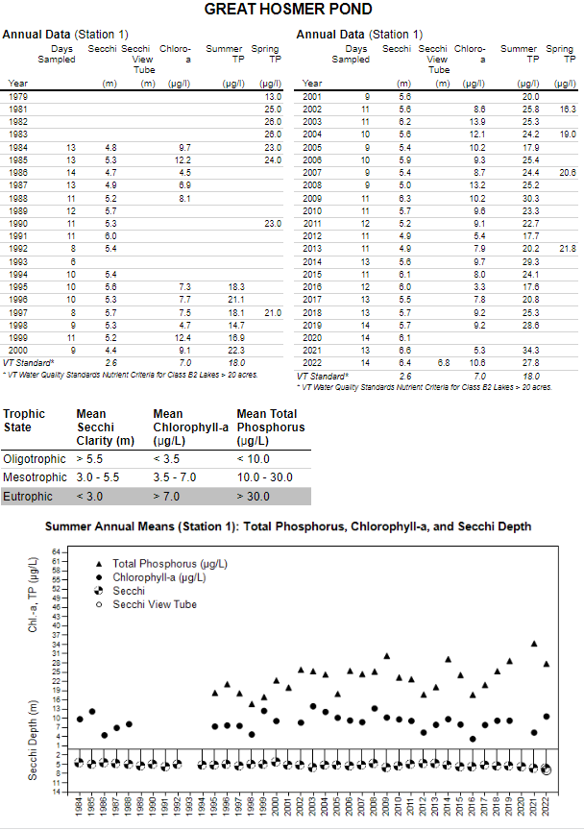
Annual Lay Monitoring Reports

Slide 9
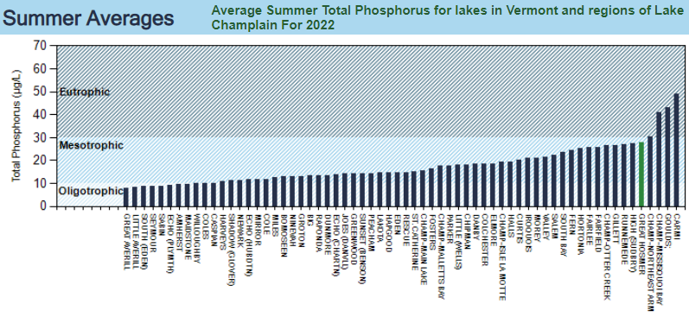
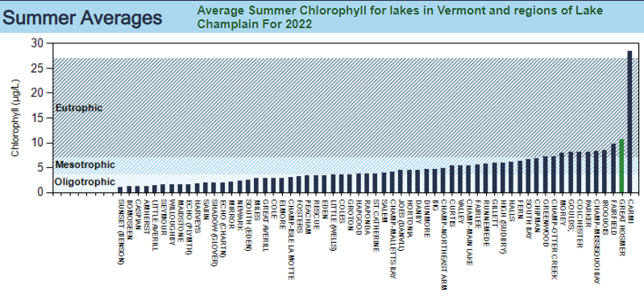

Slide 10
Annual Lay Monitoring Reports

Slide 11
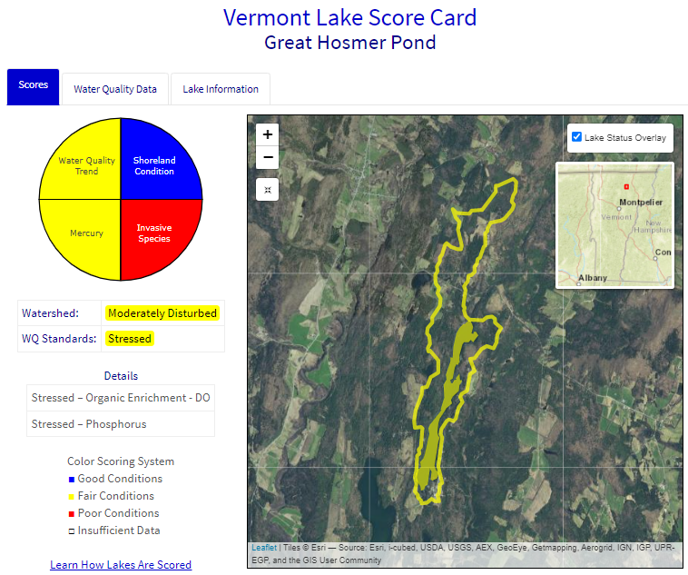
https://dec.vermont.gov/watershed/lakes-ponds/data-maps/scorecard

Slide 12
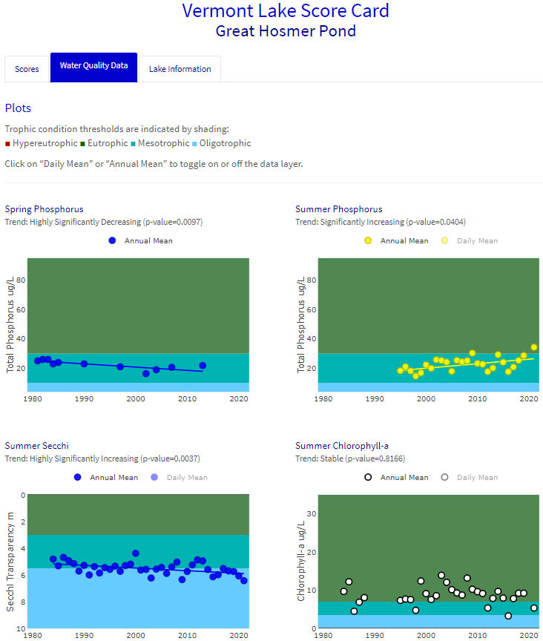

Slide 13
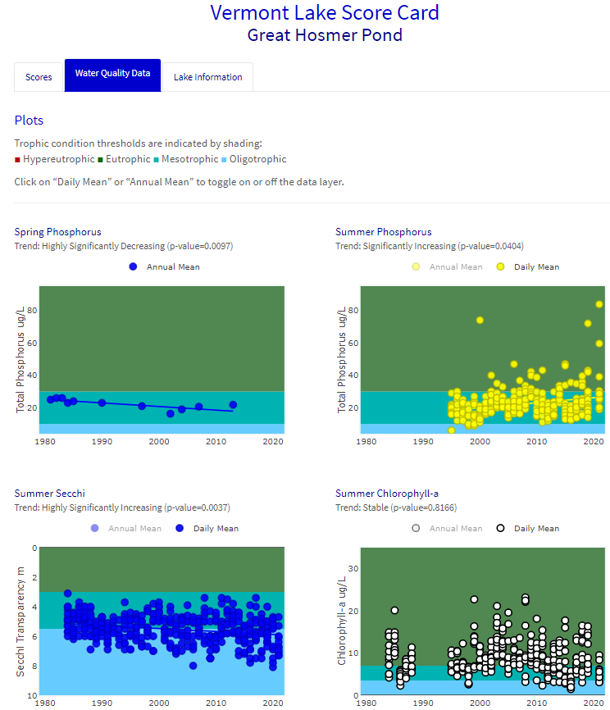

Slide 14
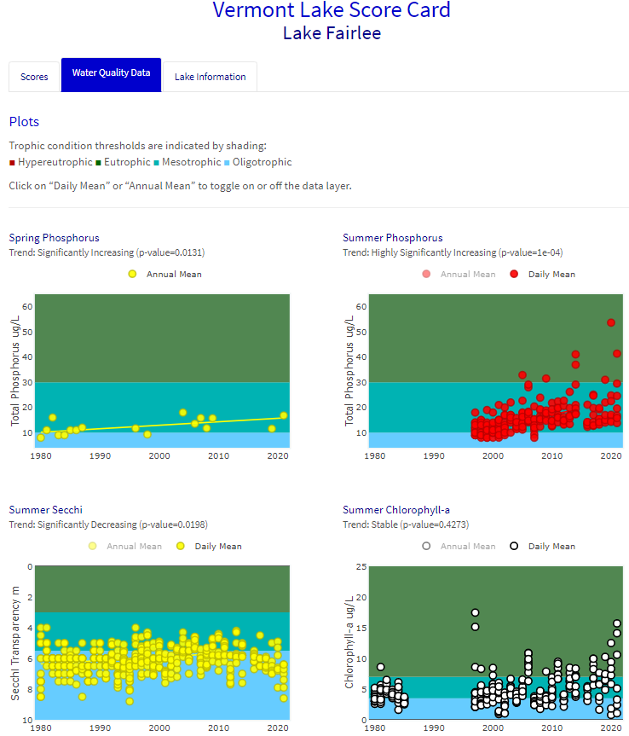

Slide 15
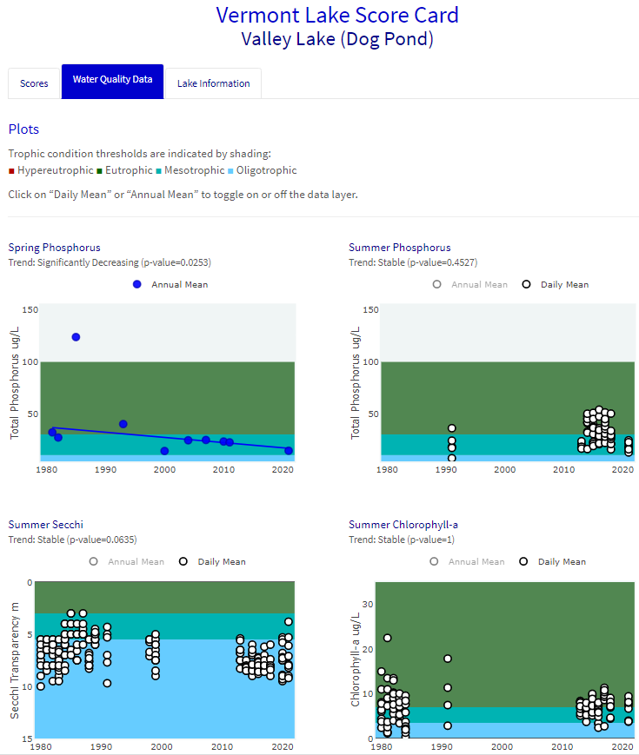

Slide 16
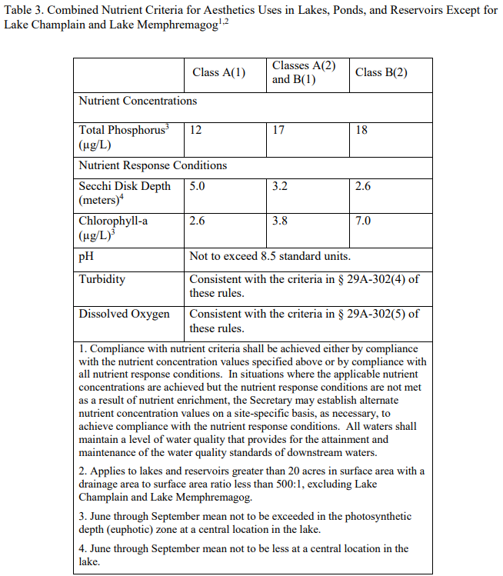
LMP Reporting: Lake Assessment Compliance with VT Water Quality Standards

Slide 17
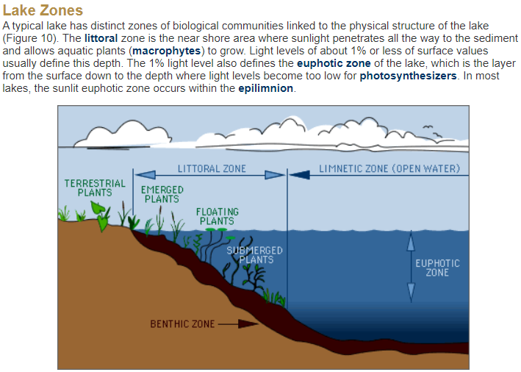
http://waterontheweb.org/under/lakeecology/10_biological_lakezones.html

Slide 18
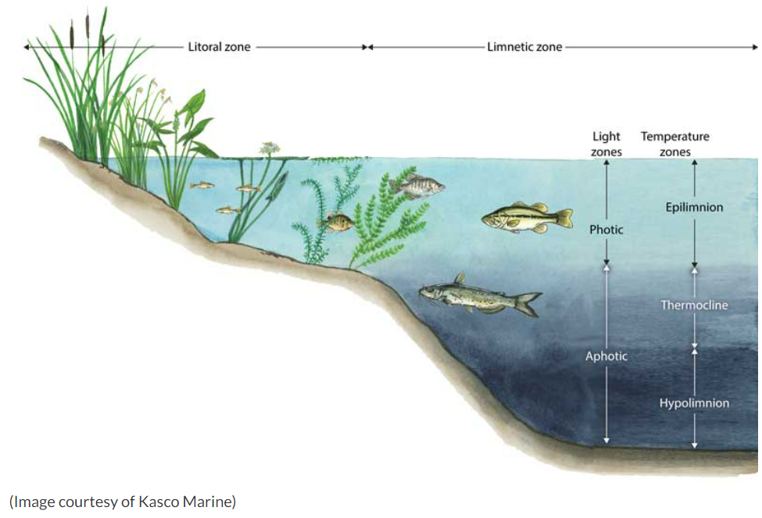
https://kascomarine.com/blog/pond-lake-zone-identification/

Slide 19
Internal Phosphorus Loading From Anoxic Sediment
Surface
Phosphorus
Thermocline
Oxygen
Phosphorus
Sediment
Time
May
September
(Image by Peter Isles, VT DEC)

Slide 20
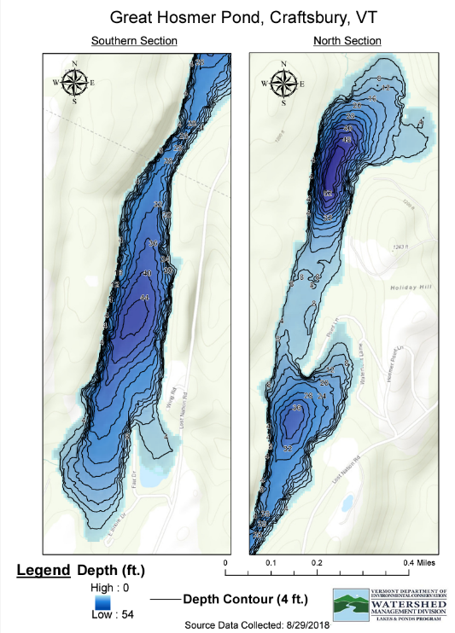
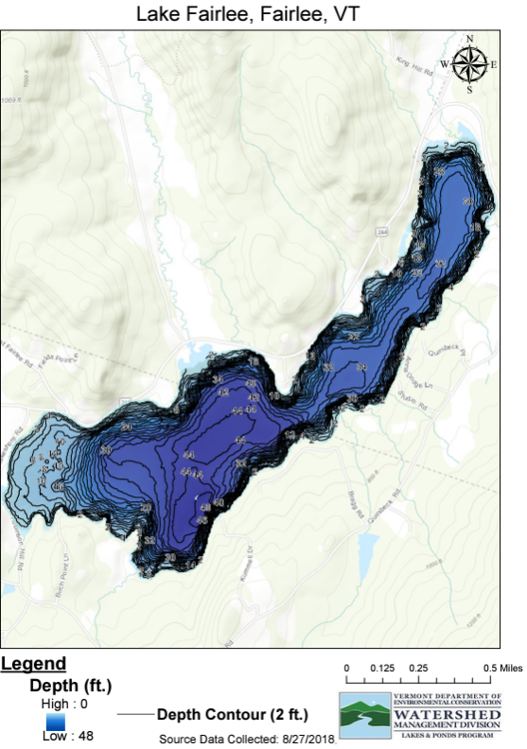

Slide 21
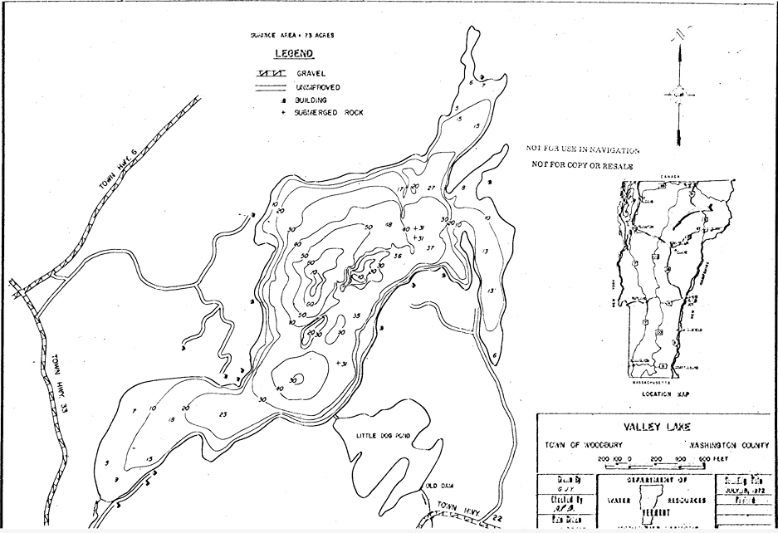

Slide 22
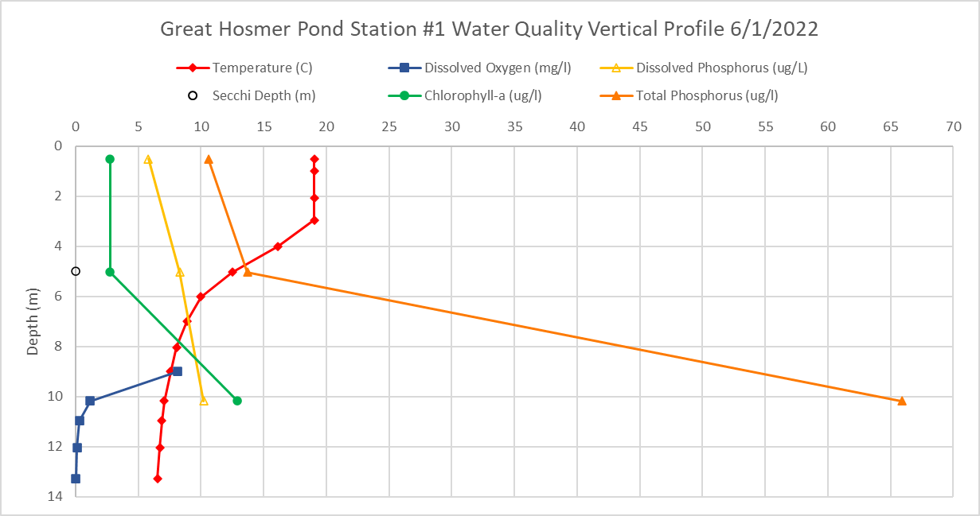
LMP Staff QC Sampling

Slide 23
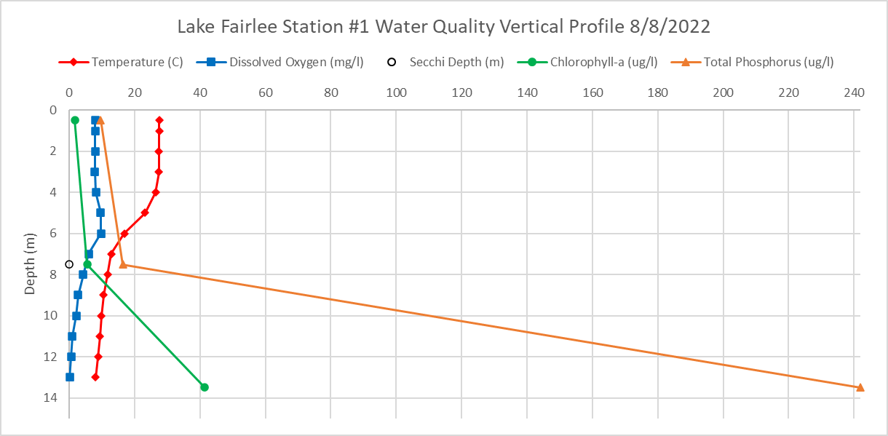
LMP Staff QC Sampling

Slide 24
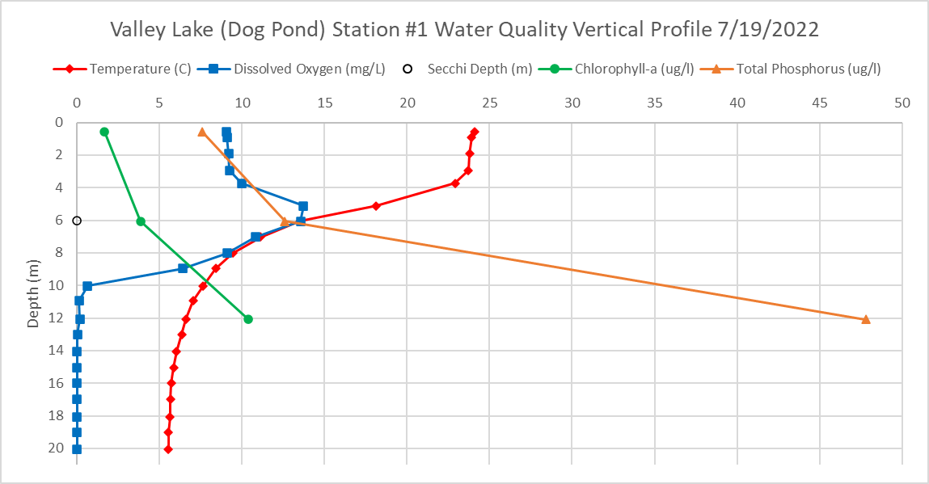
LMP Staff QC Sampling

Slide 25
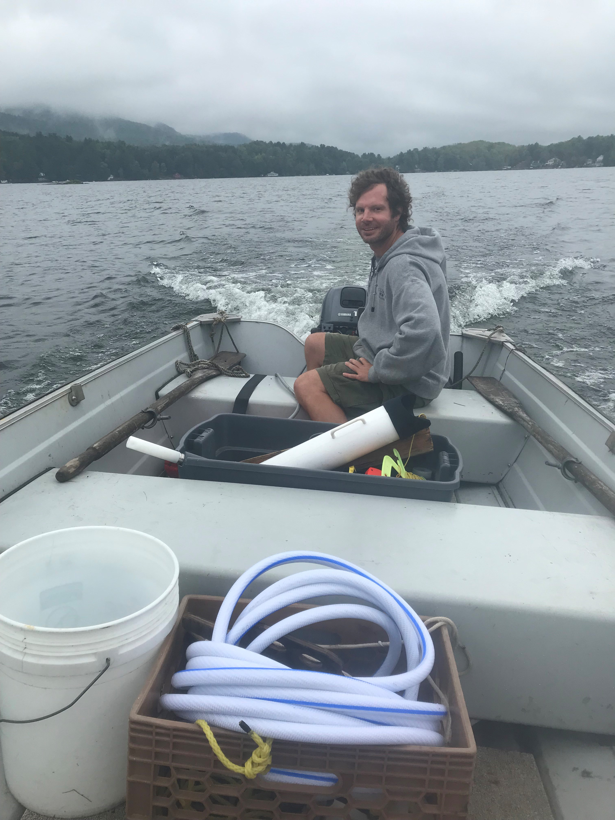
LMP Hose Sampling Methodology Considerations for Assessment
Twice Secchi depth is dynamic and can extend beyond euphotic zone and into anoxic hypolimnion
Depth-integrated sample results can be influenced by internal phosphorus loading
Need vertical profile data to inform assessment of Aesthetics Use (surface water versus deep water)
Difficult, and difficult to quality control/assure (contamination?)

Slide 26
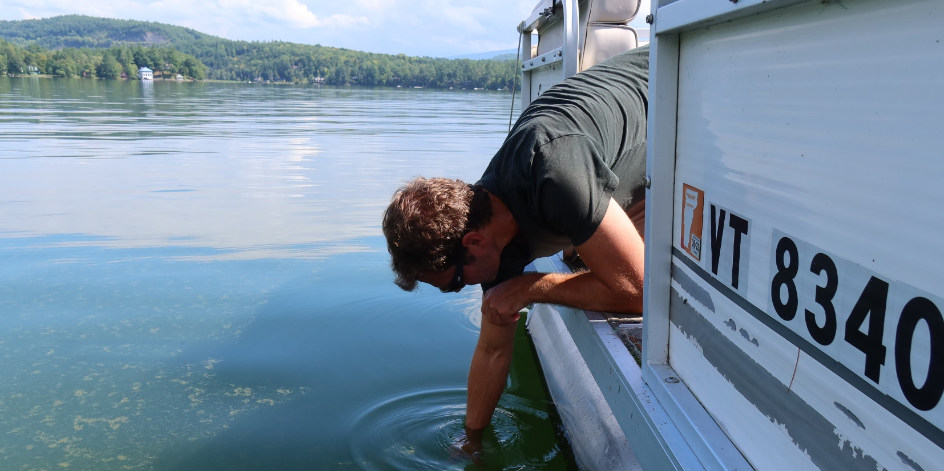
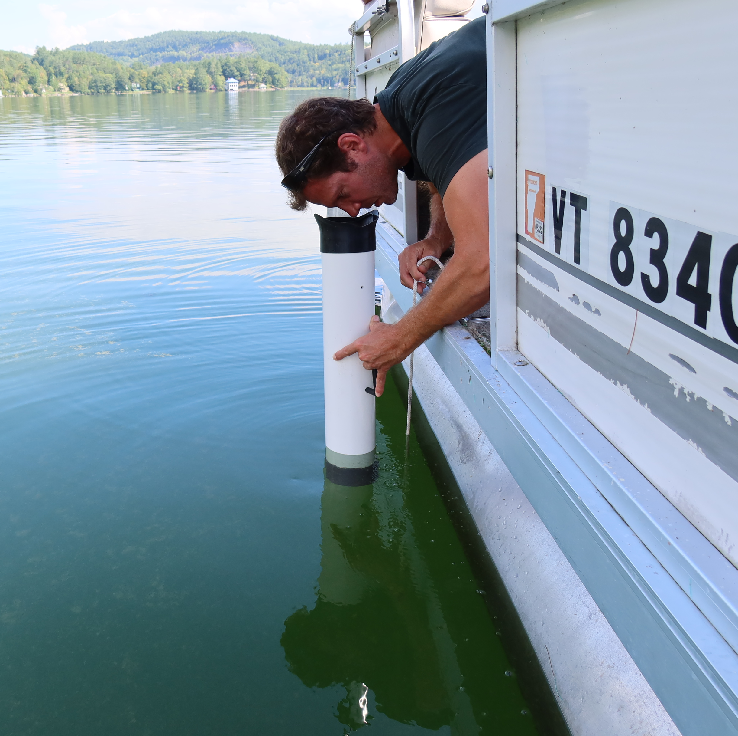
2022 LMP Sampling Methodology Pilot Study
16 lakes/monitors participated
10 lakes with significant internal phosphorus loading
Compare hose to surface samples for assessment
Correlate to Secchi depth with and without view tube/scope

Slide 27
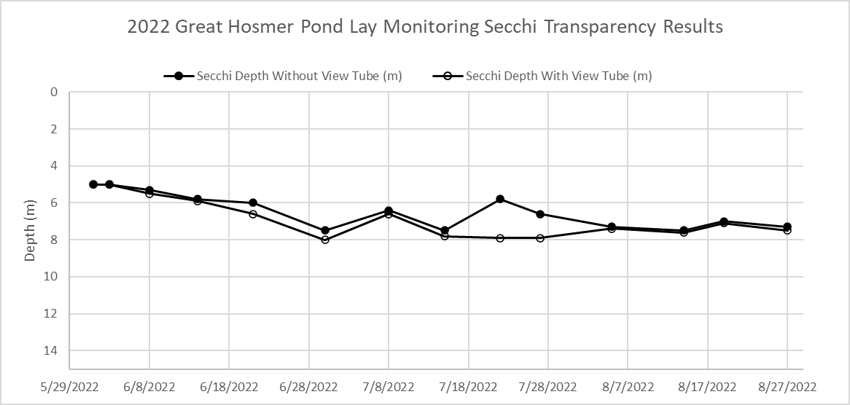

Slide 28
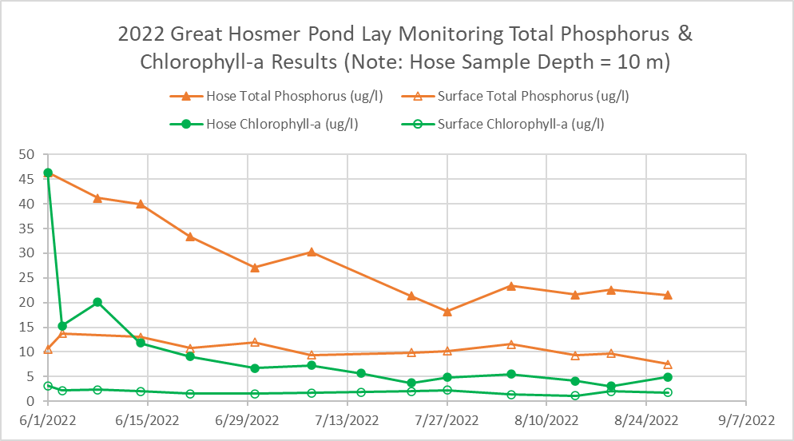

Slide 31
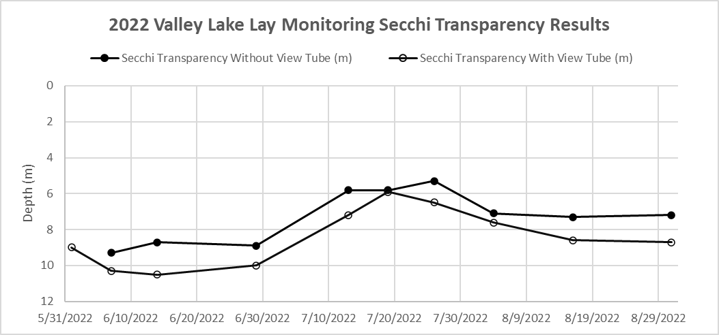

Slide 32
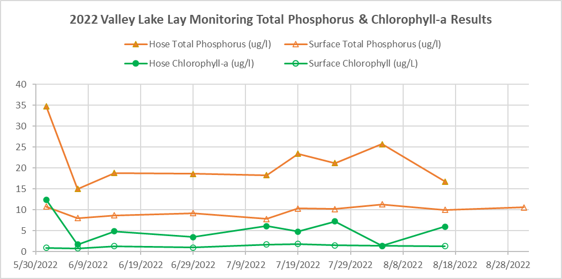

Slide 33
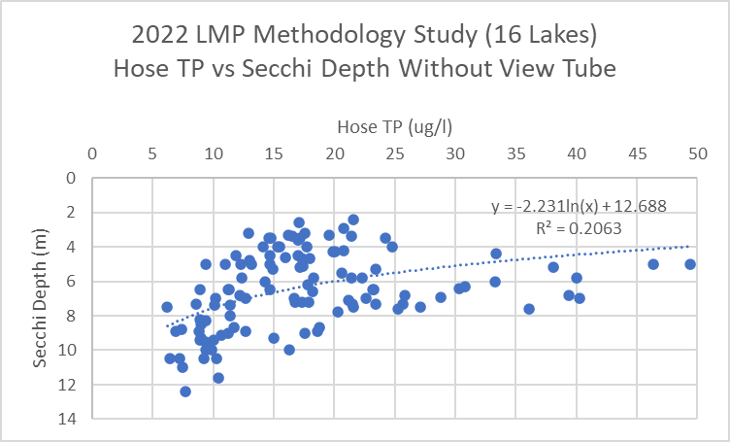
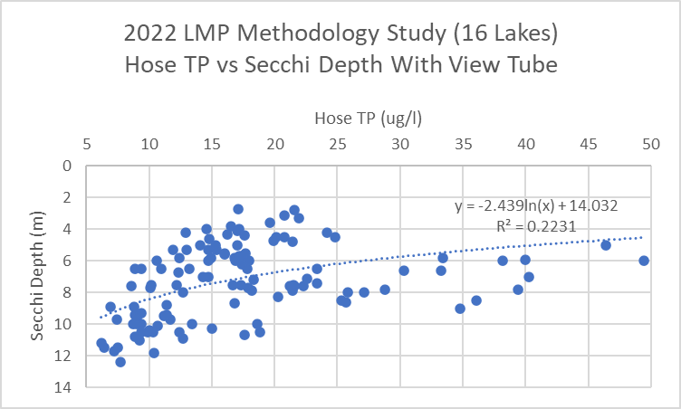
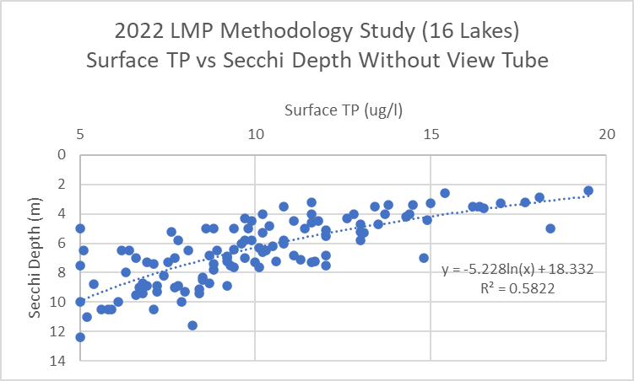
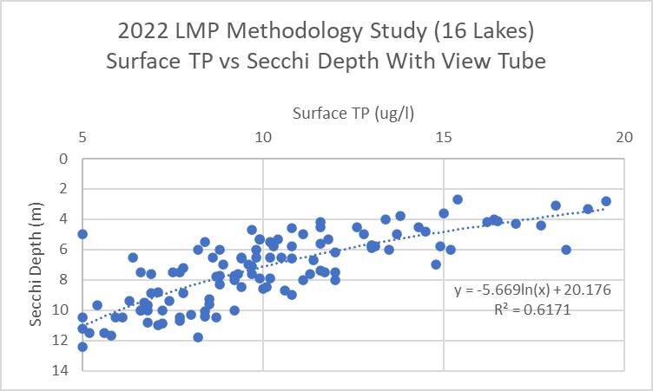

Slide 34
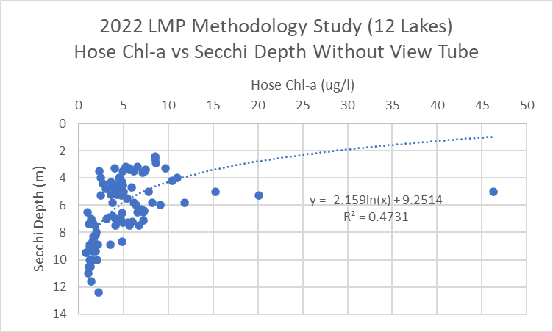
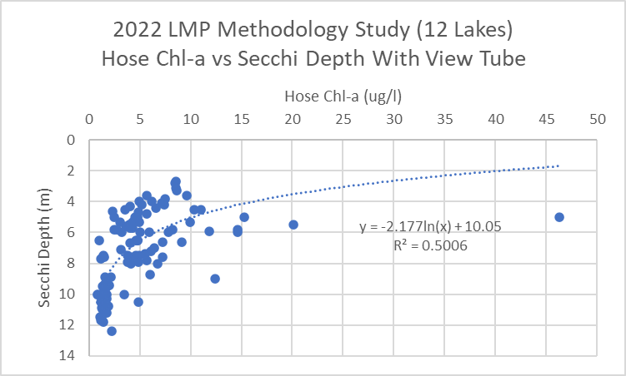
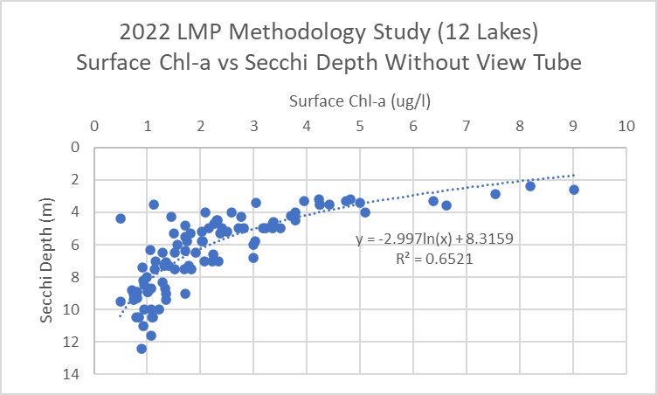
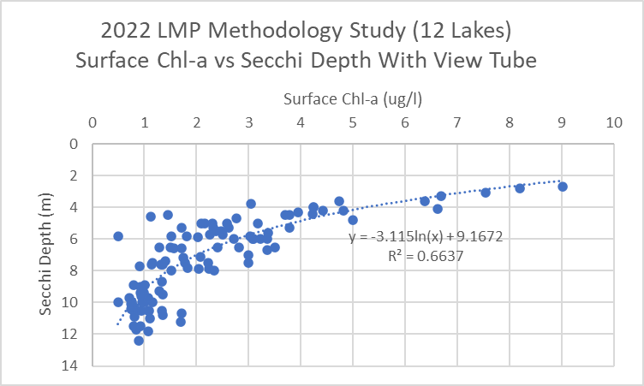

Slide 35
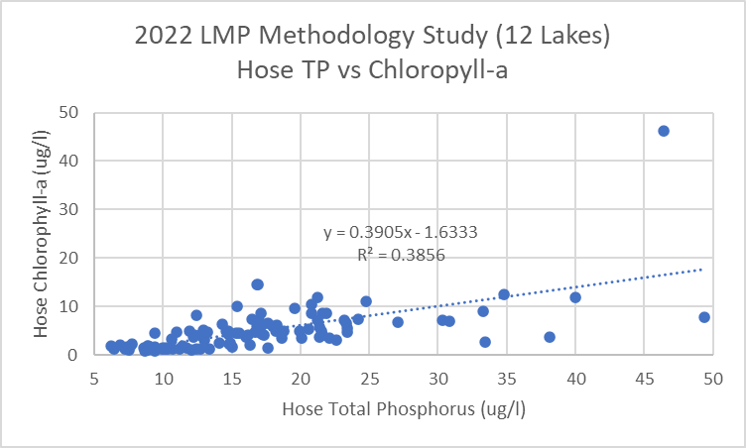
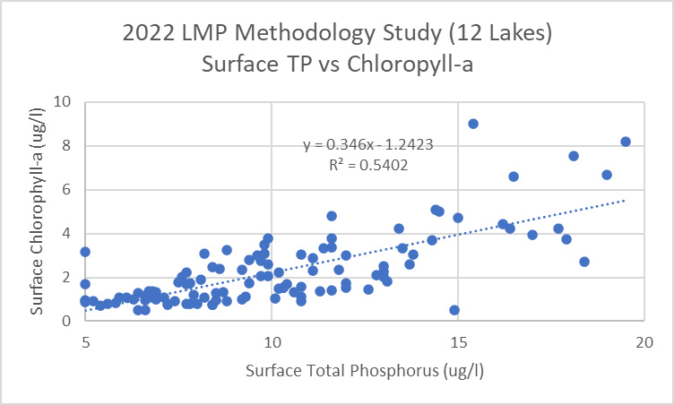

Slide 36
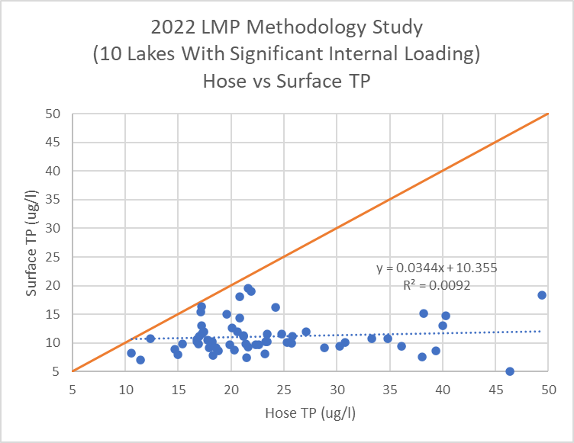
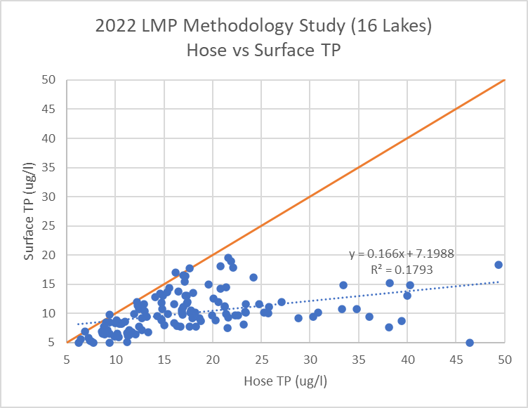
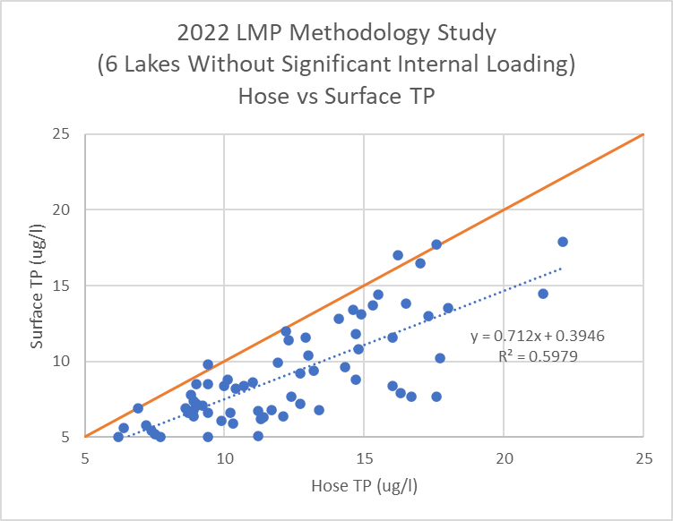

Slide 37
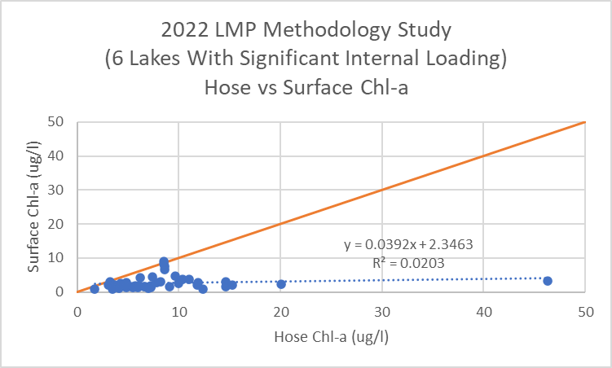
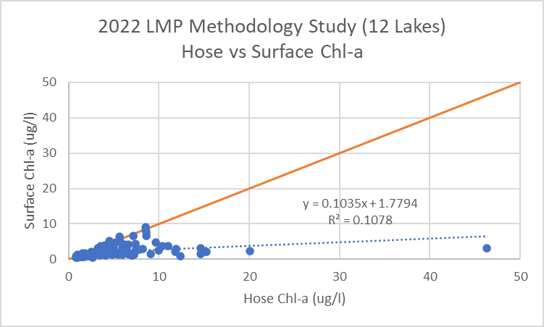
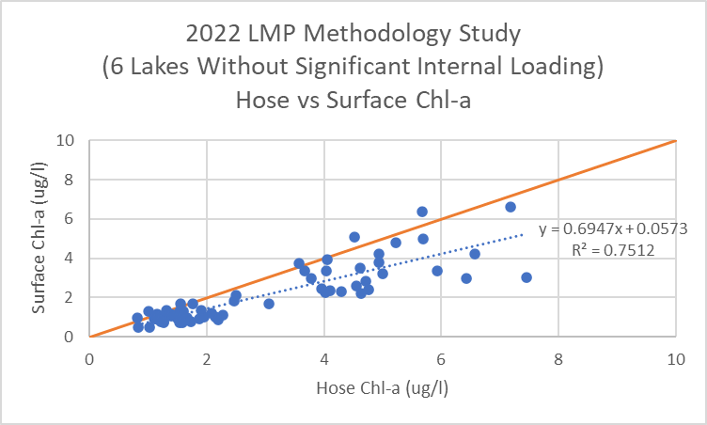

Slide 38
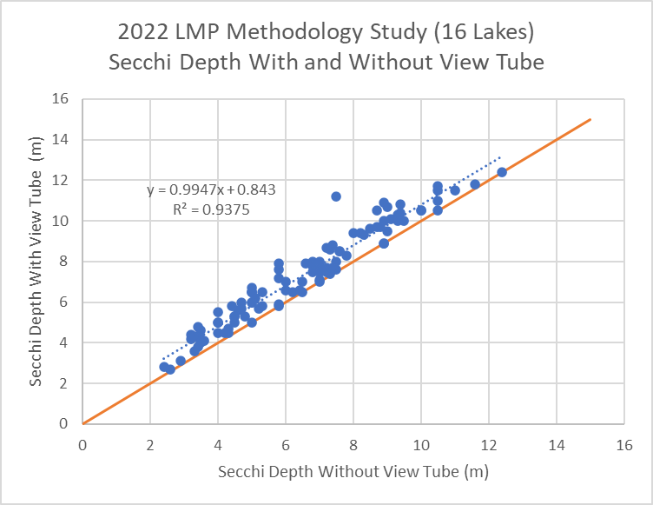
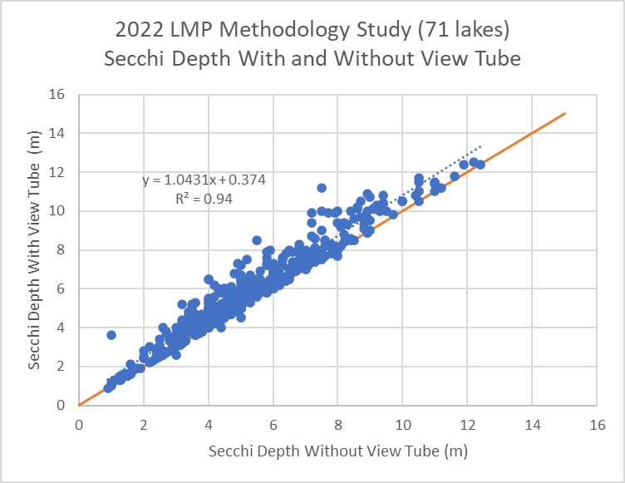

Slide 39
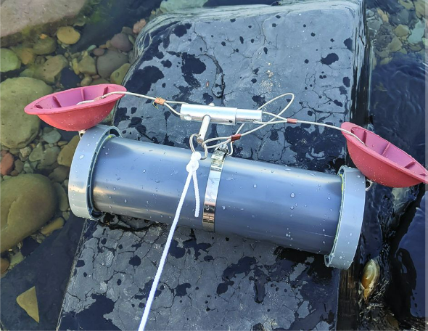
2022 Pilot Study Summary & 2023 Next Steps
2022 Pilot Study Summary
Total phosphorus and chlorophyll-a have the highest correlation with Secchi depth when using a view tube and when sampled by bottle grab at the surface instead of by depth-integrated hose at twice the Secchi depth
A deep hose sample can pick up additional total phosphorus and chlorophyll-a from internal phosphorus loading trapped in the anoxic hypolimnion of certain lakes (10 out of 16 in the study), which is evident when separating the lakes for analysis
2023 Next Steps: New LMP Protocol/QAPP (No More Hose!), similar to NY CSLAP
Lay Monitors will collect biweekly surface water bottle grab samples and optional deep water grab samples (20 m or 1 m above bottom) using equipment provided or purchased
New data will be analyzed/assessed for trends by depth, separately from historical data
Add caffeine testing pilot for sampling as tracer of human wastewater (i.e. septic systems)
geyerinstructional.com/water-sampler.html

Slide 40
THANKS! Questions?
Mark.Mitchell@partner.Vermont.gov

