Slide 1
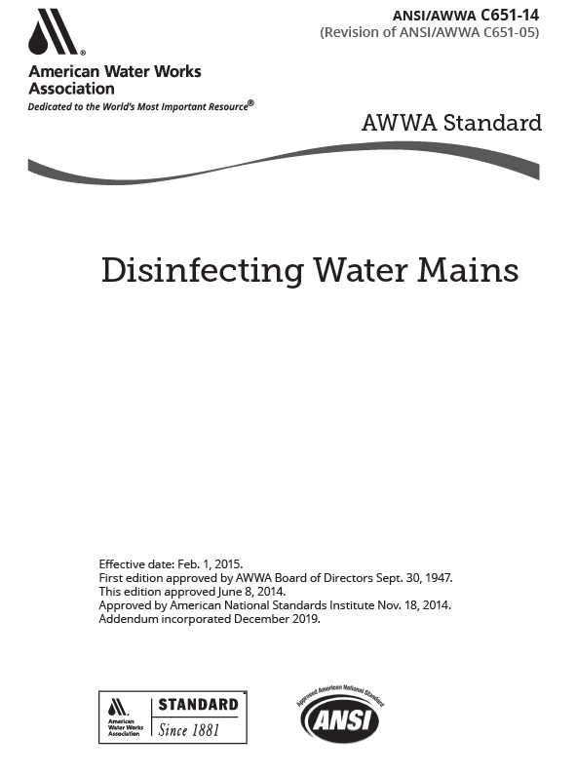
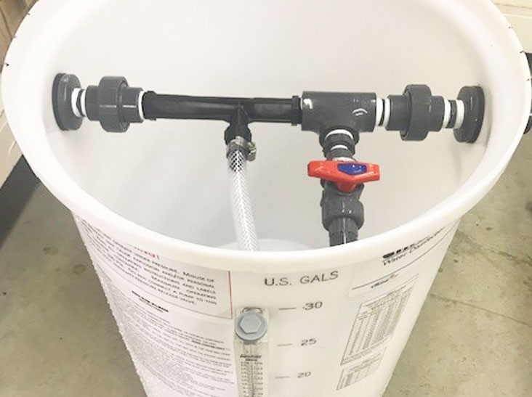
Disinfection chemicals (NSF/ANSI 60)
Water Supply Rule (WSR) Appendix A Part 8.5.7 Disinfection
All new, cleaned or repaired water mains shall be disinfected in accordance with AWWA Standard C651, latest published version.
AWWA C651 Disinfecting Water Mains
Chlorine
Calcium Hypochlorite Tablet Method
The tablet method in AWWA Standard C651 is not acceptable as per the WSR.
Sodium Hypochlorite (unscented, without optical brightening agents)
Specifications for Hypochlorite Water Treatment Chemicals
ANSI/NSF 60 Certification
NSF/ANSI 60 defines "certified product: a single product or trade designation that appears in the public listings of a Standard 60 certification agency"
Sodium hypochlorite is particularly sensitive to repackaging as two contaminants of concern increase in concentration with decomposition. The concentrations of chlorate and perchlorate can be expected to be higher in a repackaged sample than in a sample obtained from the original manufacturer because of the additional time added.
FAQs on NSF/ANSI/CAN 60 Certification
NSF/ANSI/CAN 60 Drinking Water Treatment Chemicals - Health Effects

Slide 2
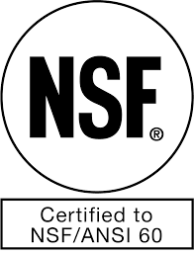
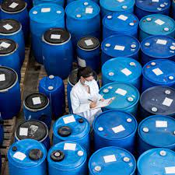
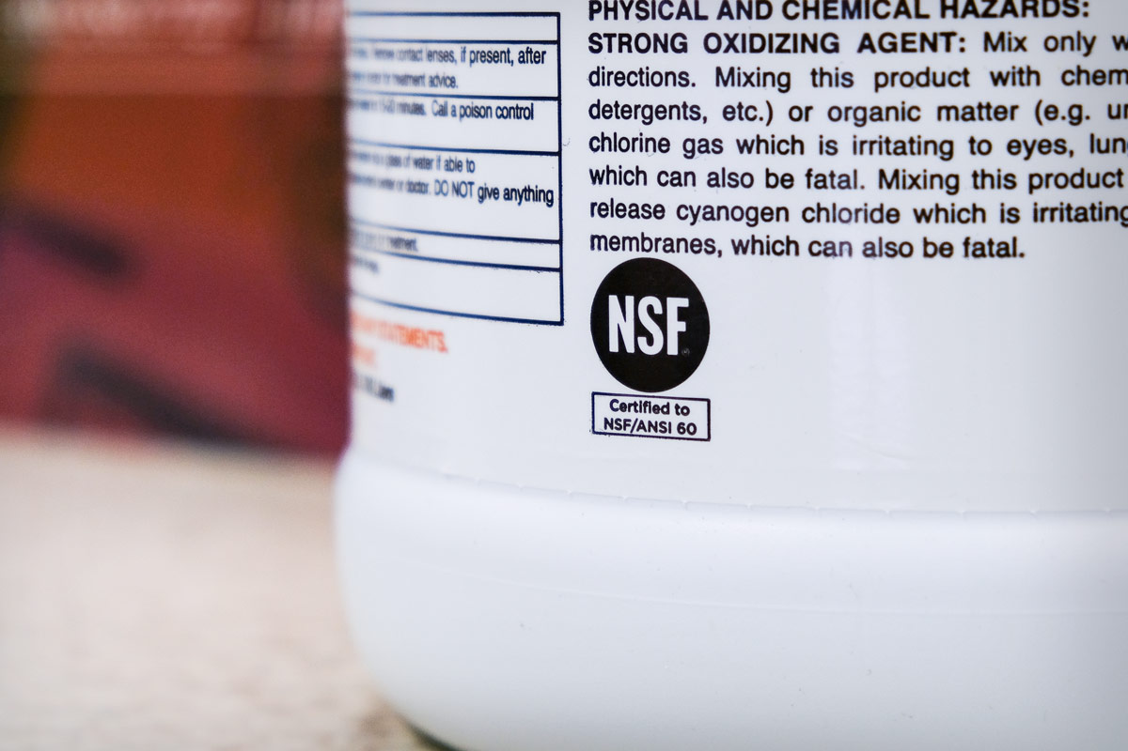
NSF 60 Q&A
Q: What should I look for to verify that a received chemical is certified to NSF/ANSI/CAN 60?
A: The company name, product name and facility designation (city and state/province/country or unique facility identification number) should be shown on the product label or accompanying documentation for bulk shipments. In addition, the NSF mark and the product’s maximum use level (MUL) are required to be on the product label or other accompanying documentation provided with the delivered product.
End users should check to ensure that the received chemicals arrive in properly sealed containers (including railcars, tank trucks, totes and drums) that are sourced directly from a company and facility that appears in the NSF/ANSI/CAN 60 listings.
The company name, product name, maximum use level, facility designation and NSF mark should match the information shown in the official NSF certification listings for the respective company and product.

Slide 3
NSF 60 Q&A
Q: What are NSF’s certification policies for treatment chemicals that are repackaged or otherwise transferred between containers off-site from the original NSF/ANSI/CAN 60 certified facility?
A: For a treatment chemical to be considered NSF certified upon arrival, the delivered product must have been inspected and evaluated at all points in the supply chain prior to reaching the water utility/end user site. Therefore, the NSF/ANSI/CAN 60 certification of a certified chemical ends (is voided) when it is repackaged, diluted, transferred between containers, blended, reacted or otherwise handled subsequent to shipment from the certified manufacturer’s location. A distributor of chemicals (originating from NSF/ANSI/CAN 60-certified source products) may apply for and obtain a separate NSF/ANSI/CAN 60 certification through NSF.
The chemical distribution location will receive site audits by NSF as well as testing of at least one representative product sample to the requirements of NSF/ANSI/CAN 60. The site audits and product testing are conducted prior to certification and on an annual basis after certification is granted. These monitoring activities are conducted to ensure that chemical products are protected from contamination during transport and delivery to the water utility/end user site.

