Slide 1
PFOA Public Meeting
Bennington/North Bennington
Tishman Hall, Bennington College
September 28, 2016

Slide 2
Welcome and Introductions
Alyssa B. Schuren, Commissioner, DEC
Agenda:
Bennington/North Bennington site & sampling updates
Blood testing & health updates
Municipal line & Saint-Gobain conversations
Questions & Answers

Slide 3
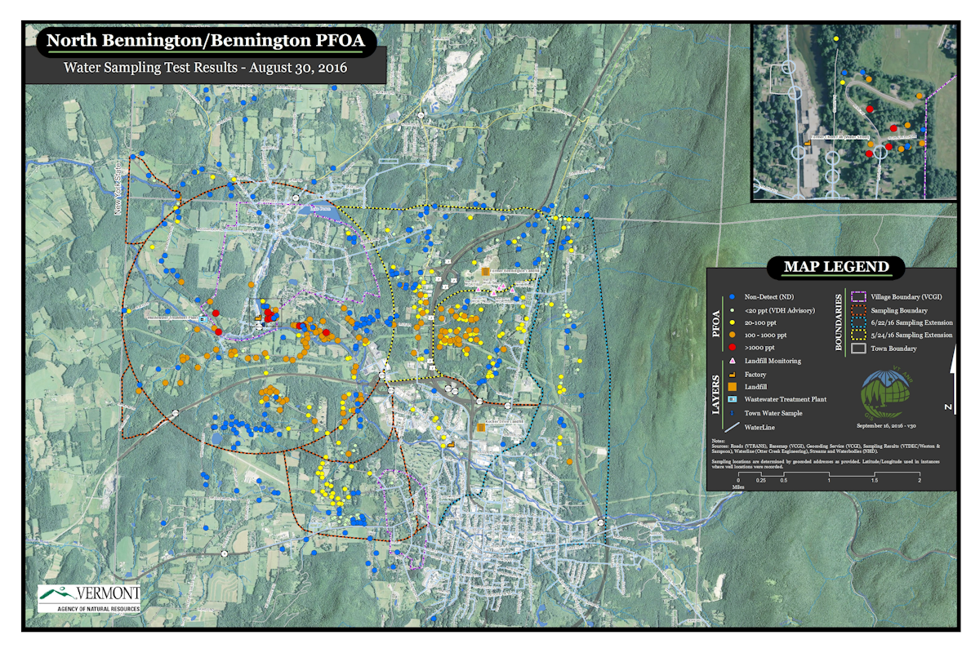

Slide 4
Current PFOA Private Well Results
541 samples collected from private wells
199 results : ND (37%)
76 results : 0-20 ppt (14%)
266 results : >20 ppt (49%)

Slide 5
Bottled Water & Resampling Update
No longer any drop off locations
Home delivery only
Resampling wells < 20 ppt
Future sampling will be based on results

Slide 6
POET Update
  POETs installed – 244
  POETs to be installed - 11
  First time sampled – 232
  Second time sampled – 199
  Third time sampled - 134
  Influent concentrations vary (4,600–<20 ppt)
  Midpoint – All ND (<20 ppt)
  Effluent – All ND (<20 ppt)

Slide 7
POET Update
Initial sampling
  All POETs will be sampled 3 times
  Ongoing sampling
  >1,000 ppt - quarterly
  200-1,000 ppt – twice a year
  <200 ppt – sampled annually
  All carbon beds will be changed at a minimum every other year.

Slide 8
Blood Clinic & Health Updates
Update from Shannon Tatro,
Department of Health

Slide 9
PFOA Blood Clinics
November 14 from 1:00 p.m. – 7:00 p.m.
November 15 from 8:00 a.m. – 1:00 p.m.
Location: Department of Health 324 Main St. Bennington
Eligibility – If DEC tested the well of the home in North Bennington or Bennington where you live now, or any time in the past eight years, and/or you worked or lived at the former Chemfab/Saint-Gobain site at 940/1030 Water Street in North Bennington, or you work or live there now.
http://survey.healthvermont.gov/s3/PFOA-Blood-Draw-Registration

Slide 10
Process for Moving Forward with Long-Term Solution
Update from
DEC Commissioner Schuren

Slide 11
Major Milestones for Long-Term Solution
Define scope
of problem
  Complete site investigation
  Investigate and plan for final design
What’s the smartest way to fix it?
  Submit Corrective Action Plan (CAP)
  Approve Corrective Action Plan (CAP)
Make the solution happen
  Implement corrective actions
  Begin construction and site remediation work

Slide 12
Questions?

