Slide 1
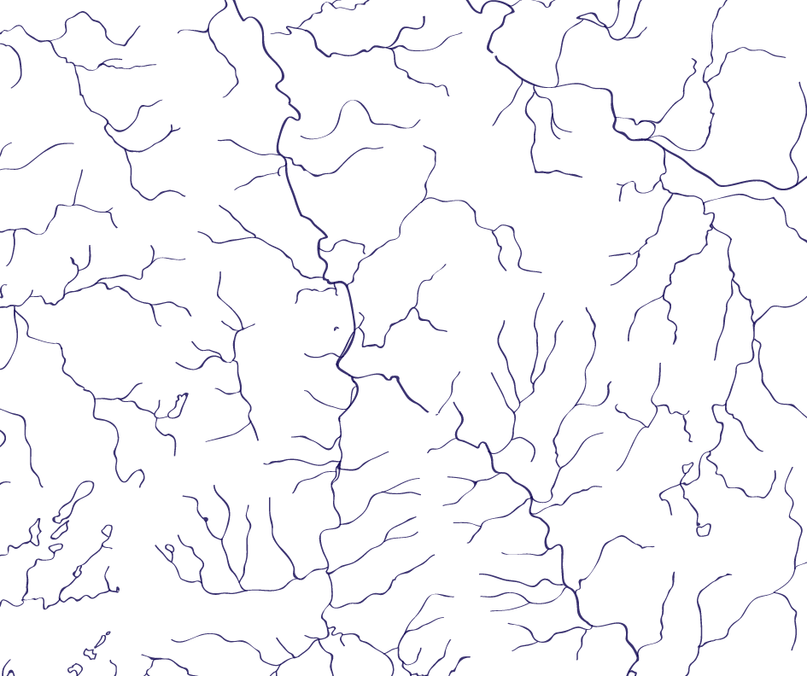
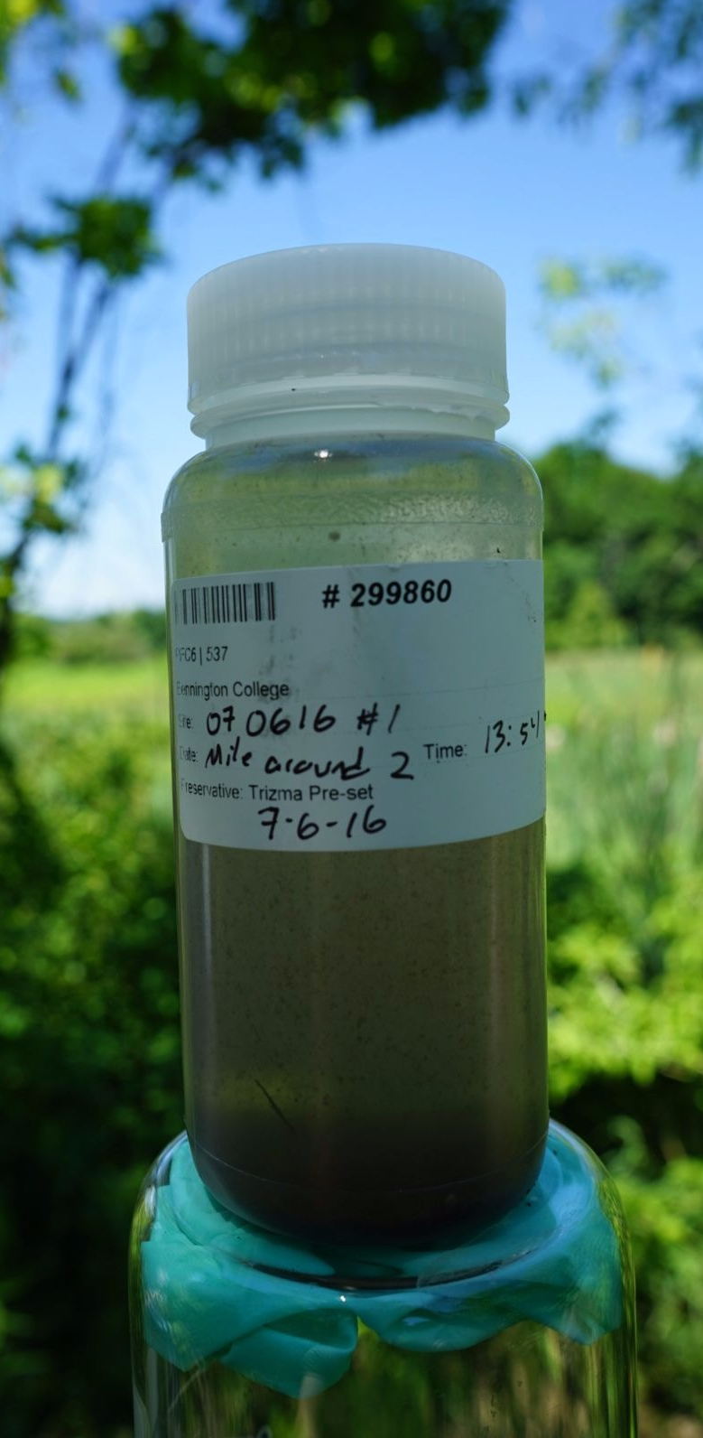
Understanding PFOA
Bennington College
David Bond
Janet Foley
Tim Schroeder

Slide 2
Understanding PFOA
Developed and taught new course introducing students to the chemical properties, environmental pathways, and regulatory assessments of PFOA (Spring 2016 / Fall 2016).
Opened class to the community members from Hoosick Falls and Bennington (public school teachers, nurses and doctors, journalists).
Trained students and local residents to collect water samples and interpret laboratory results.

Slide 3
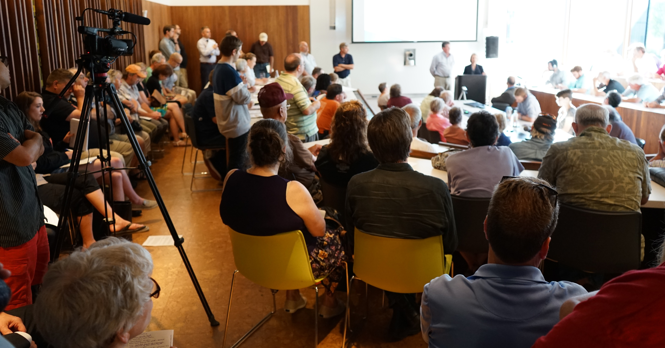
Working with Community Questions
“Is PFOA in
our maple syrup?”
“Is there any
PFOA in my pool?” “There’s a natural spring on my property near the plastics plant. Can you test it?”
“I live outside the
current testing area “How stable are the initial readings
but I think there is an illegal dump nearby. of PFOA levels in my well?”
Can you test my well?”
“I have a very contaminated well and now I have a filtration system.
But I’m afraid there could be residual PFOA in my water pipes. Is there?”

Slide 4
Variation in PFOA Concentration in Groundwater over Past Year
Measured change in PFOA levels at individual groundwater sampling sites.
Data from state samples and POET monitoring samples.
231 Wells with multiple sampling times
109 Wells increased in PFOA concentration
119 Wells decreased in PFOA concentration
Median variation from initial to most recent sample = 24%

Slide 5
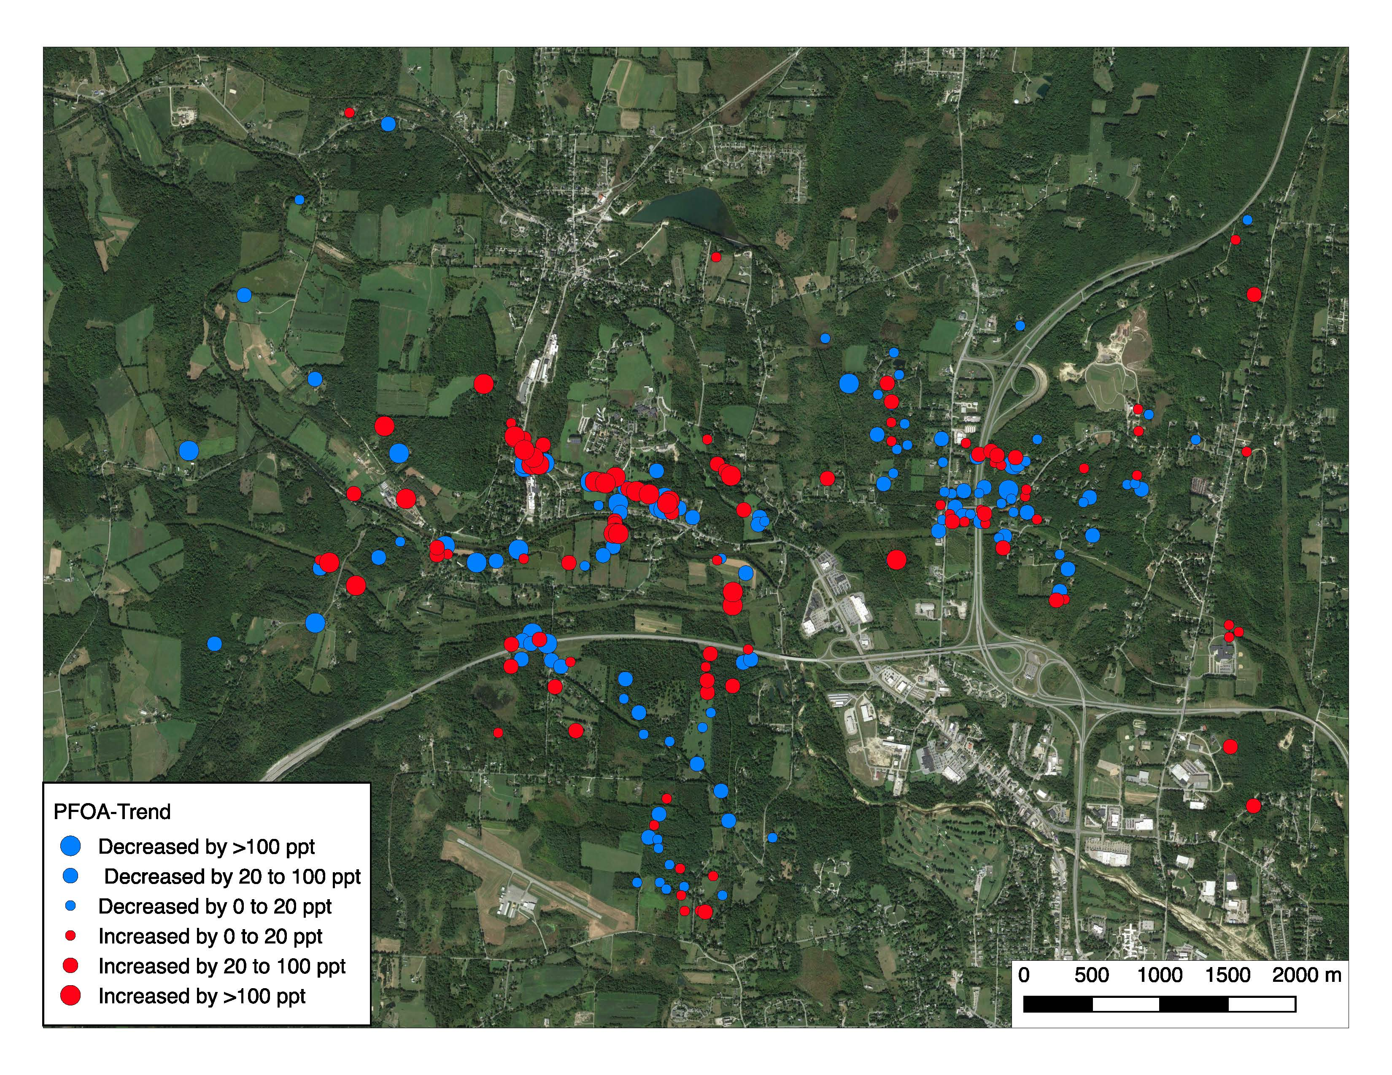

Slide 6
Percentage variation in PFOA does not vary with initial concentration

Slide 7
Thank You
David Bond
Janet Foley
Tim Schroeder

